Slide 1
Customizing Text-to-Image Models with a Single Image Pair
Maxwell Jones Sheng-Yu Wang Nupur Kumari
David Bau Jun-Yan Zhu
Notes:
Thanks for the introduction Kfir!
I'm Maxwell, and today I'll be presenting on Customizing Text-to-Image Models with a Single Image Pair. This work was conducted with Sheng-Yu, Nupur, David, and Jun-Yan from CMU and Northeastern.

Slide 2
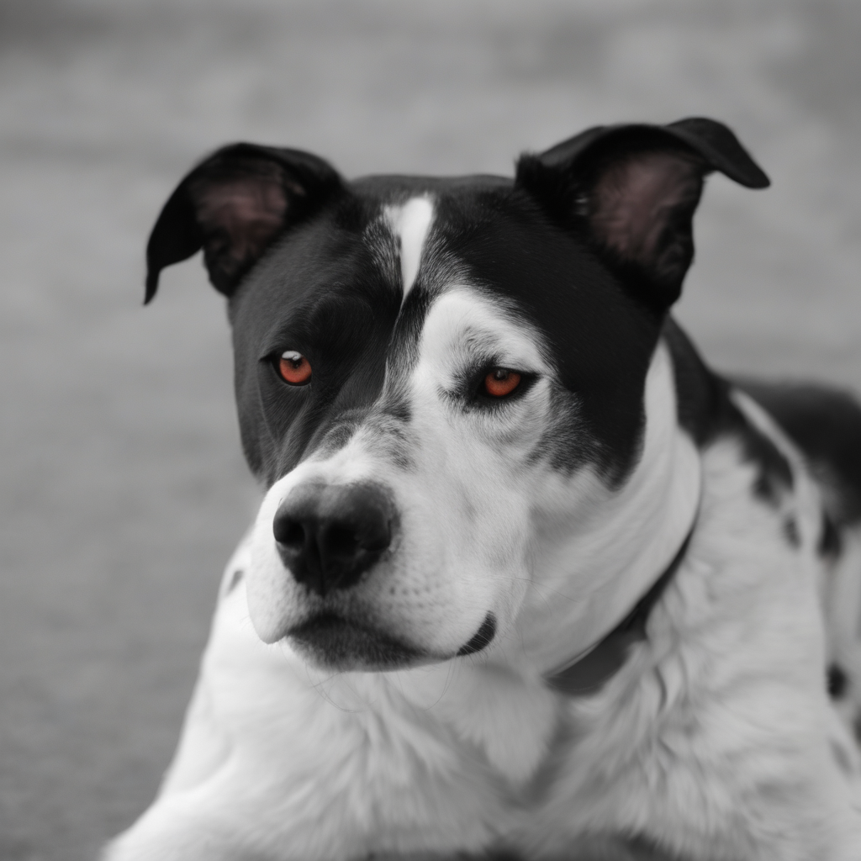
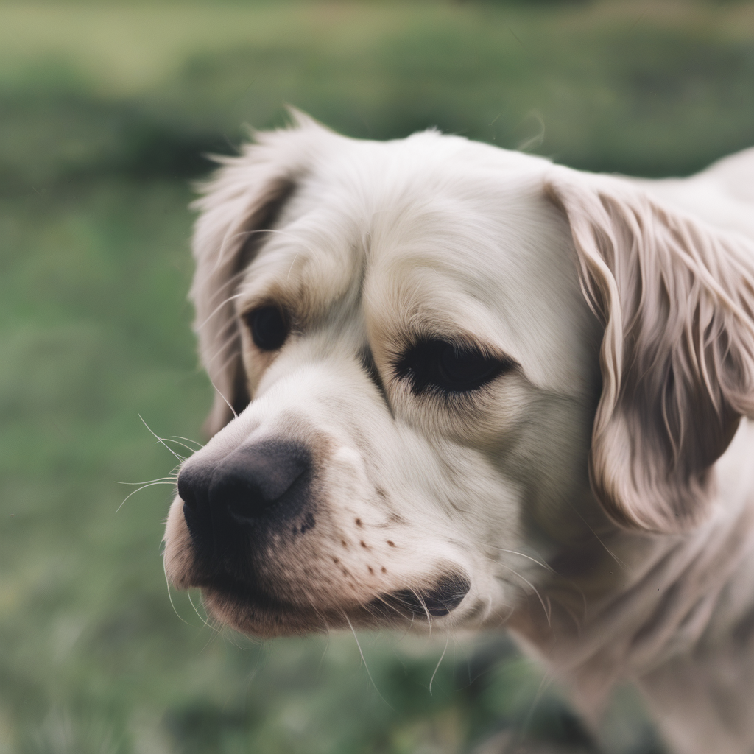
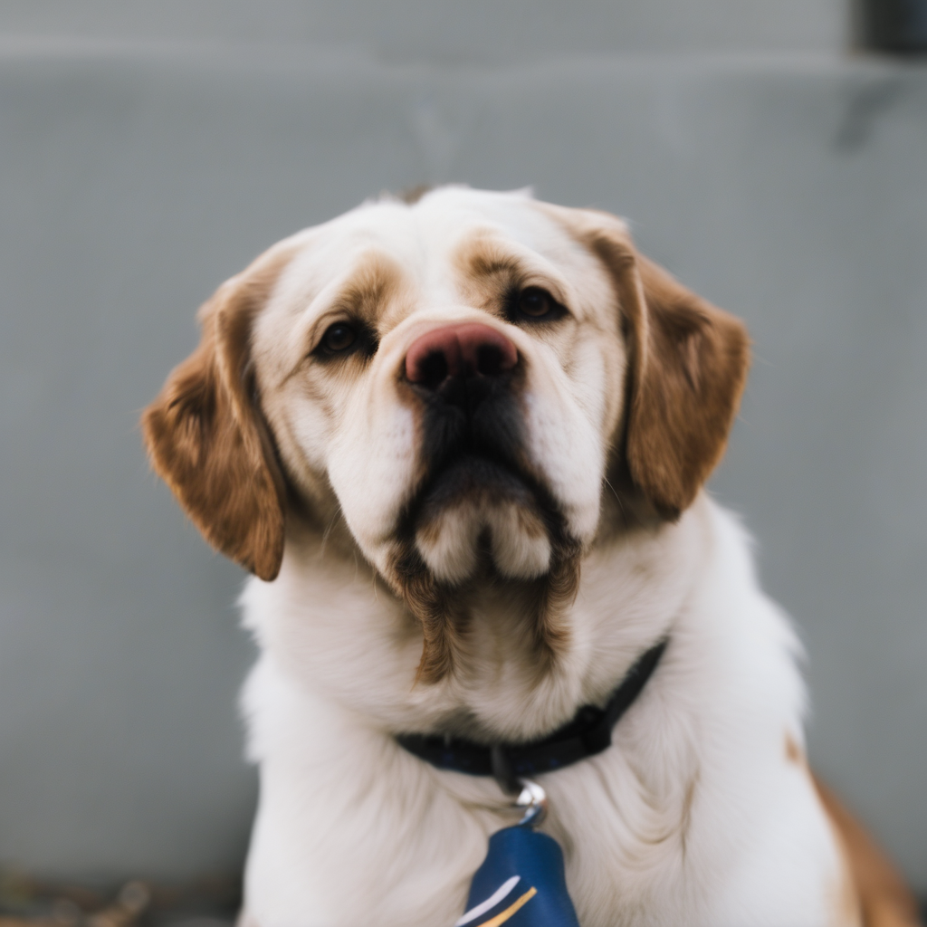
Large-Scale Text-to-Image Models
Caption: “A photo of a dog”
Pretrained
U-Net
seed 1
seed 2
seed 3
Many Denoising Steps
DDPM [Ho et. al, NeurIPS 2020]
Latent Diffusion Models [Rombach et al. CVPR 2022]
Stable Diffusion XL [Podell et al. arxiv 2023]
Notes:
Recently, Large Scale text-to-Image denoising models have shown great advances in image quality and coverage.
These models take in noise maps, along with a text caption, and iteratively denoise these noise maps into images. Here we see some nice, diverse dog images.

Slide 3
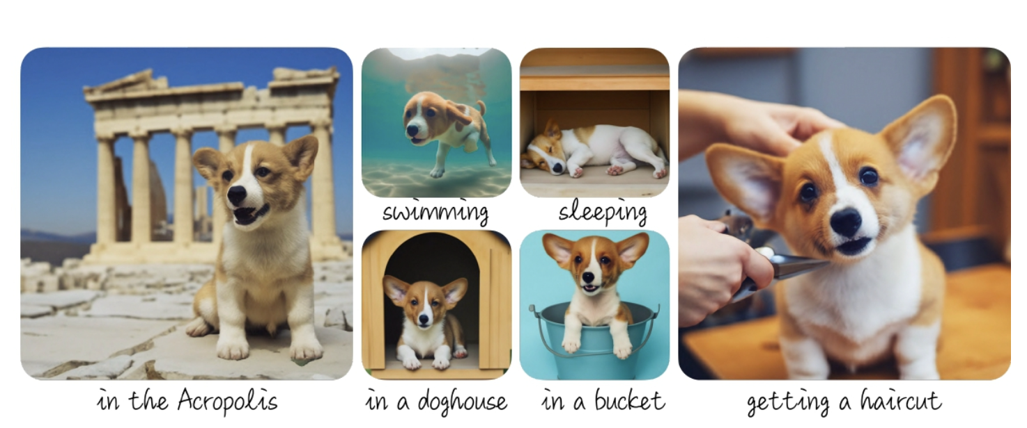
Model Customization
Standard
Customization
Input subject images
Finetune text-to-image model
Standard
Customization
Input single style image
Finetune text-to-image model
Dreambooth [Ruiz et al. CVPR 2023]
Custom Diffusion [Kumari et al. CVPR 2023]
Textual Inversion [Gal et al. ICLR 2023]
Styledrop [Sohn et al. CVPR 2023]
Notes:
prior work has proposed customizing these models with a few images of a specific subject. After some finetuning, the updated text to image model can be used to generate the subject in new contexts.
This approach has been extended for learning style, where we finetune with as little as a single image, and generate new images in the style of the original image

Slide 4
Style is ambiguous with only stylized images
Standard
Customization
Notice: All stylized images are brown toned – is this really part of the style??
Let’s investigate further…
Input single style image
Finetune text-to-image model
Notes:
In the stylization case, all stylized images have the brown tone of the building in the training example. With just the style image, it's unclear if the final images are overfitting, and we should probably investigate further

Slide 5
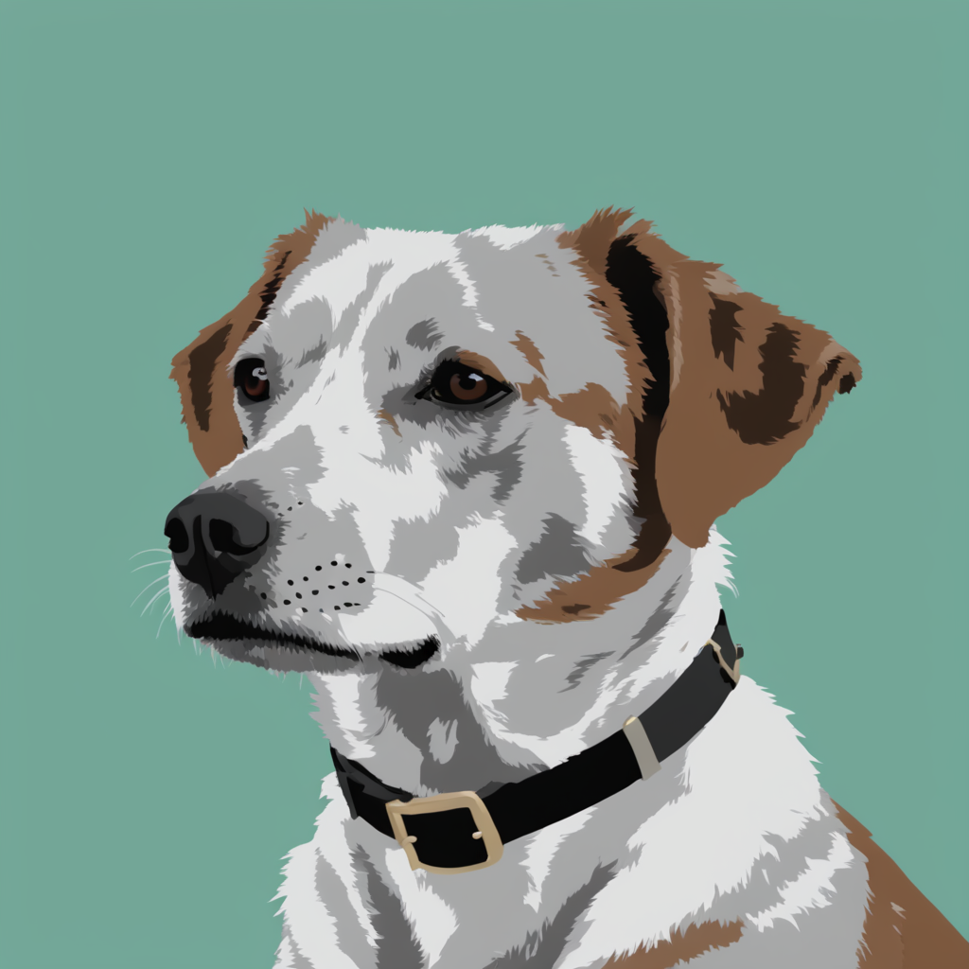
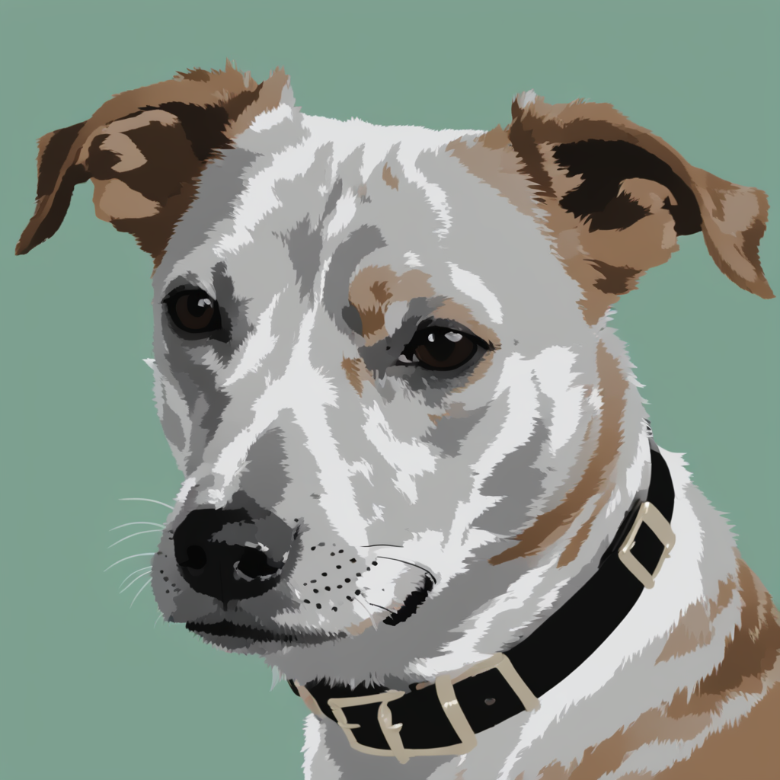
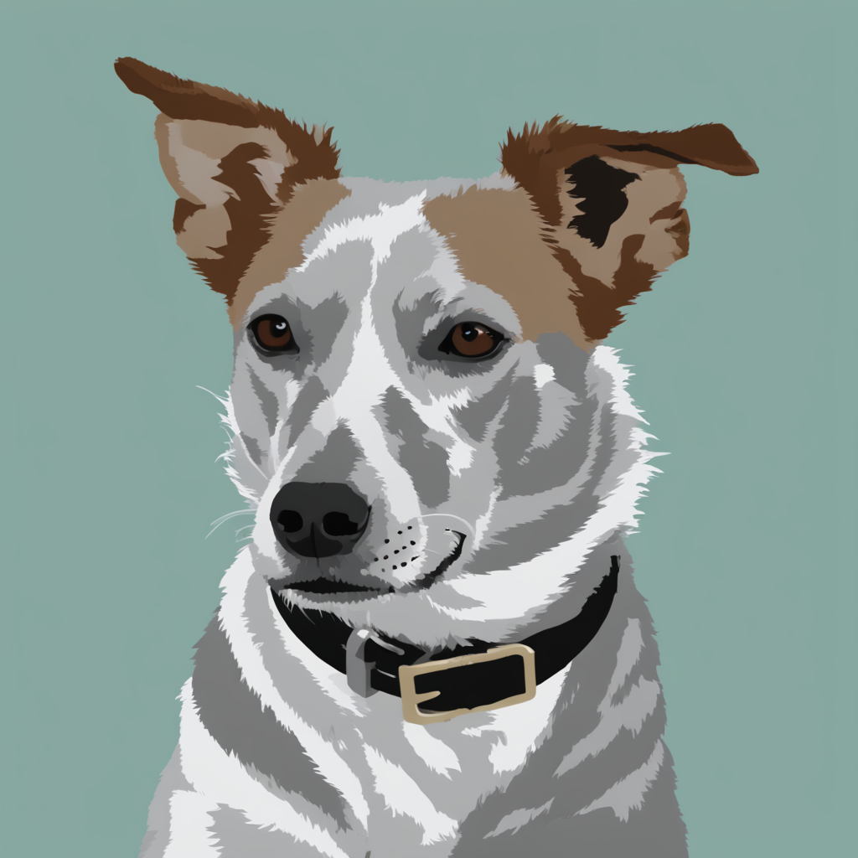
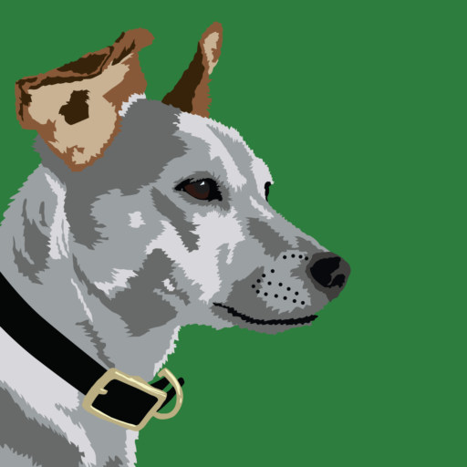
Style is ambiguous with only stylized images
Original Generative Model
Pretrained
Standard
Customization
Style image
fine-tune on style images only
seed 1
seed 2
seed 3
Overfit to background color
Overfit to dog in image (head shape, ears, collar)
Notes:
let's consider this stylized dog image. the Pretrained model can output diverse dogs, but after standard customization, the outputted dogs overfit to the head shape, ears, and collar of the training image, as well as the training image's green background

Slide 6
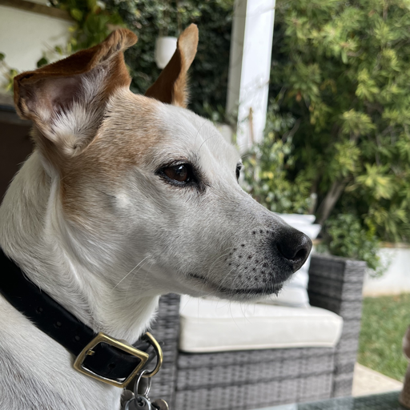
Image Pair
To disambiguate between content and style, let’s learn style from an image pair!
Content image
Style image
Image credits: Jack Parkhouse
Notes:
to disambiguate between content and style, we propose learning from a pair of images - both with and without the stylization!

Slide 7
Problem: Standard Methods tend to overfit
Original Generative Model
Pretrained
Standard
Customization
Style image
fine-tune on style images only
seed 1
seed 2
seed 3
Overfit to background color
Overfit to dog in image (head shape, ears, collar)
Notes:
we can now consider our stylization problem with an image pair instead of a single image

Slide 8
Problem: Standard Methods tend to overfit
Original Generative Model
Pretrained
Image Pair
Standard
Customization
Content image
Style image
fine-tune on style images only
seed 1
seed 2
seed 3
Overfit to background color
Overfit to dog in image (head shape, ears, collar)
icon credits: vecteezy.com
Notes:
we can now consider our stylization problem with an image pair instead of a single image

Slide 9
Problem: Standard Methods tend to overfit
Original Generative Model
Pretrained
Image Pair
Standard
Customization
Content image
Style image
only train
on style image
seed 1
seed 2
seed 3
Overfit to background color
Overfit to dog in image (head shape, ears, collar)

Slide 10
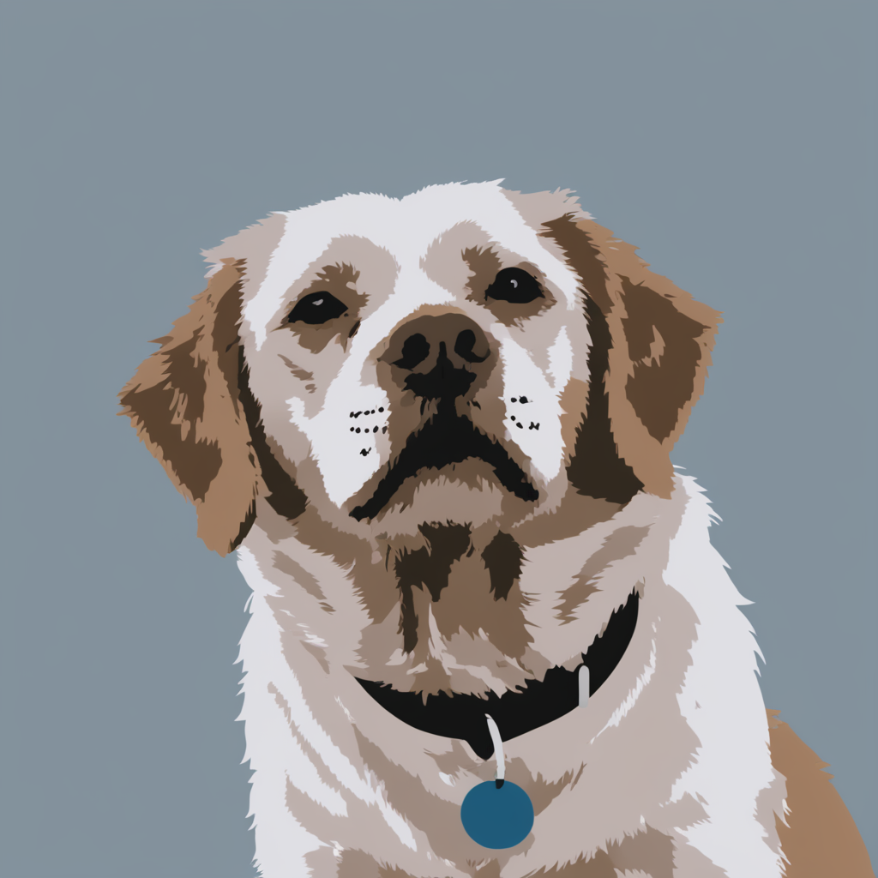
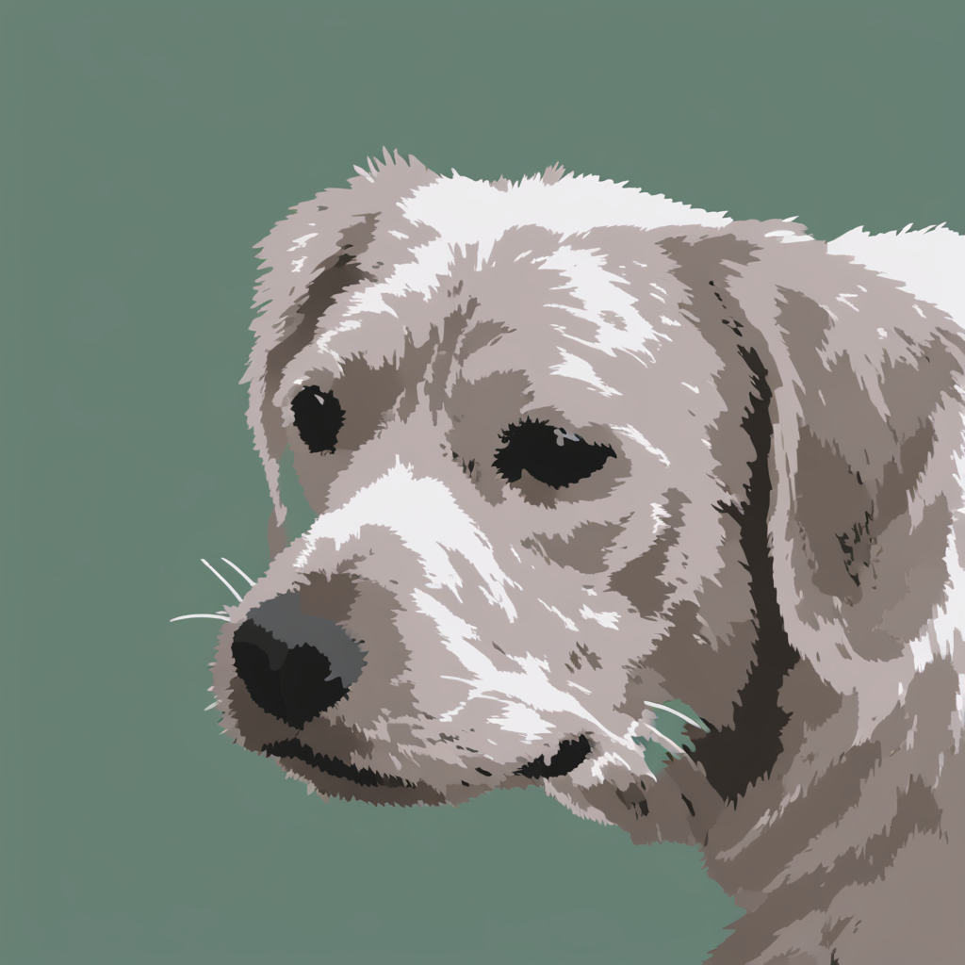
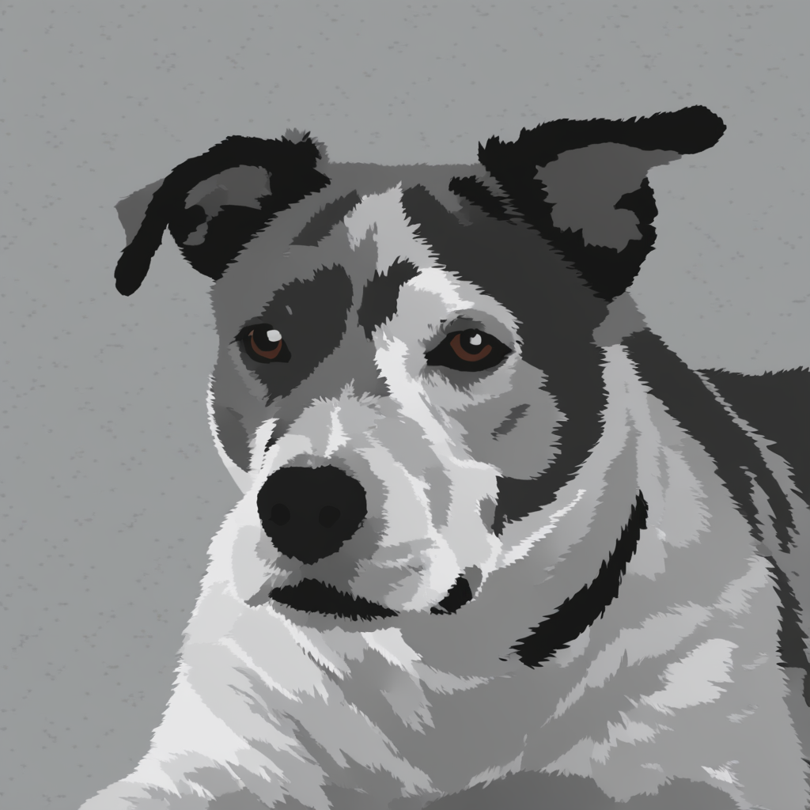
Solution: Learn Stylistic Difference From Image Pair!
Original Generative Model
Pretrained
stylistic difference
Image Pair
Pair
Customization
Content image
Style image
Standard
Customization
only train
on style image
seed 1
seed 2
seed 3
Notes:
our method learns the stylistic difference from this image pair during training, generating diverse results that respect the style! When generating images with the same noise seed as the pretrained model, our customized model outputs stylized versions of the pretrained outputs!

Slide 11
Image Pair
How does our method differ from standard techniques?
Content image
Style image
Notes:
Next, lets deep dive into how our training and inference pipelines differ from standard techniques

Slide 12
Standard Customization Step
output
B = 0
Pretrained Weight Layer
Sample random timestep t
A = $𝒩(0, σ^{2})$
Low Rank Weight Update
input
Pretrained
_{“A photo of a} dog in digital illustration style”
LoRA citation
Simo citation
Notes:
During the standard customization step, our training image is first noised to some level t. Next, the noisy image is passed through the pretrained model with learnable weight updates. Instead of updating the original model weight layer, input features are passed through both the pretrained weights, and a set of learnable weight update matrices, with a bottleneck dimension that keeps the update low rank. these two updated features are then added for the final output

Slide 13
Standard Customization Step
Update LoRA (Low Rank Adapters)
Sample random timestep t
Low Rank Weight Update
Pretrained
Loss
_{“A photo of a} dog in digital illustration style”
_{Predicted Noise}
_{True Noise}
Notes:
the denoising model outputs a noise prediction, and a loss function is applied between the noise prediction and true noise to the original image. Finally, this loss is used to update the trainable low rank adapters.

Slide 14
Our Customization Step
Update Content Weights
Sample random timestep t
Content Weight Update
Pretrained
Loss
_{“A photo of a}
_{V* dog"}
_{Predicted Noise}
_{True Noise}
Content Weight Update
Content Weight Update
Pretrained
Loss
Style Weight Update
_{“A photo of a}
V* dog in digital illustration style”
_{Predicted Noise}
_{True Noise}
Update Style Weights (Only)
Notes:
In Our method, we add noise to both images. (slowly) Our key idea is to separate learning content and style into two different low rank updates. first, the content weight update is applied to predict noise for the content image. Then, both content and style weight updates are applied to predict noise for the style image (pause) the content weights help anchor the prediction to the content image, so the style weights only need to focus on learning the stylistic difference between the content and style images.
Losses are then computed, and the content weights and style weights are updated. Importantly, only the style weights are updated when predicting the styled image noise. Also, only the style weights will be used at test time.

Slide 15
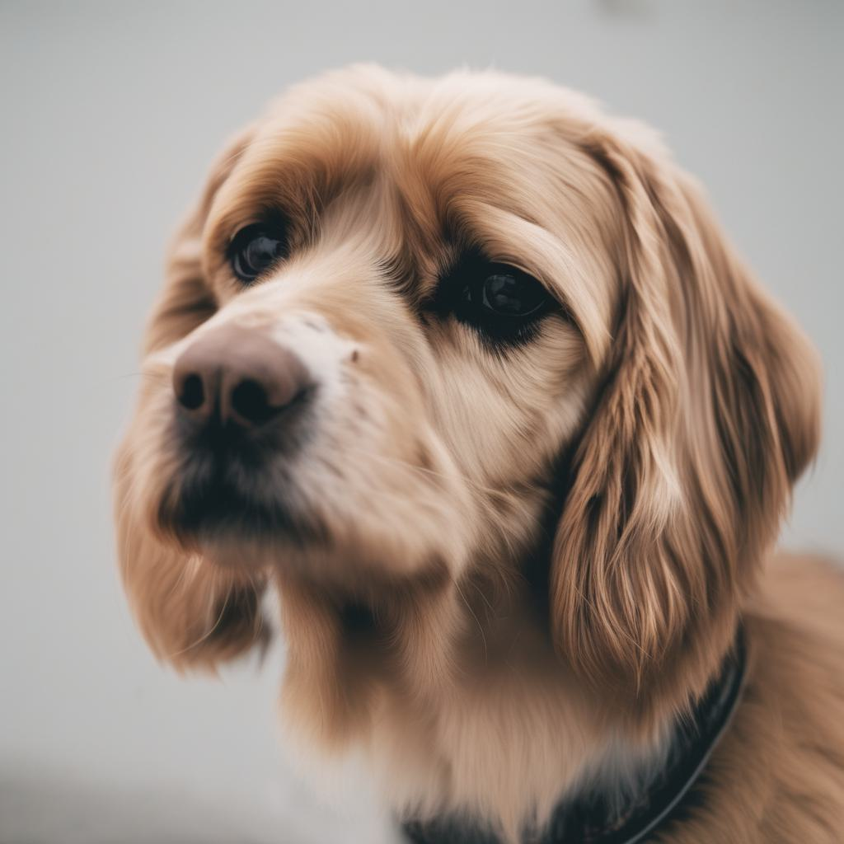
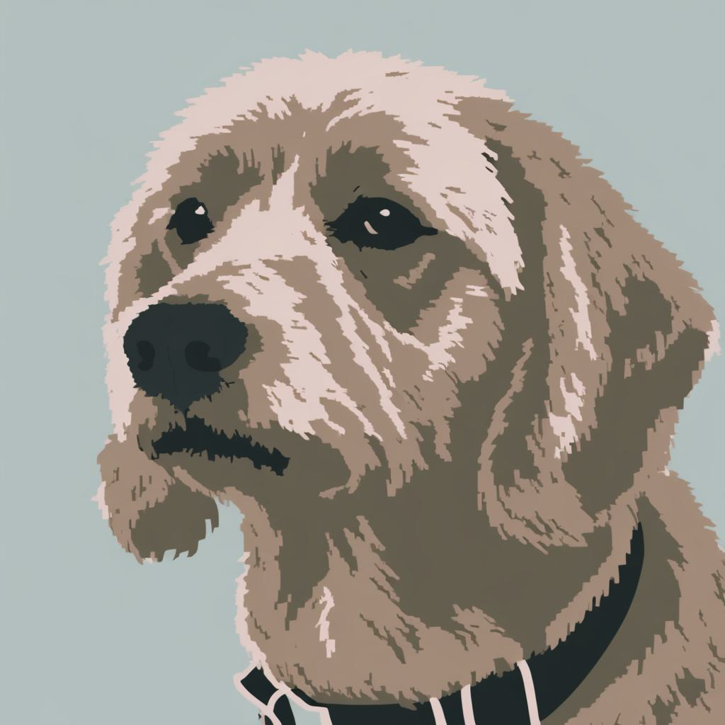
Inference
“A photo of a dog”
Pretrained
_{Same noise seed}
Pretrained
“A photo of a dog in digital illustration style”
Style Weight Update
Inference: Generate style images with same layouts
Notes:
during inference, we note that using the same noise seed for both generation with a pretrained model and styled generation with only the style weights yeild stylized image pairs, showcasing the success of our method to only learn style in the style weight update..

Slide 16
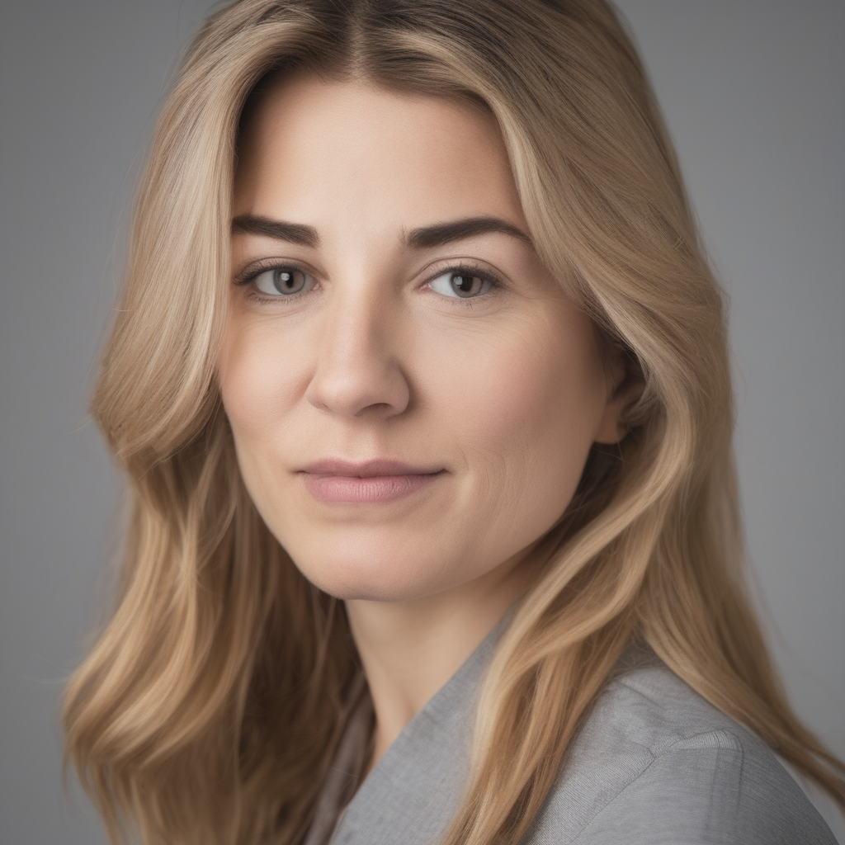
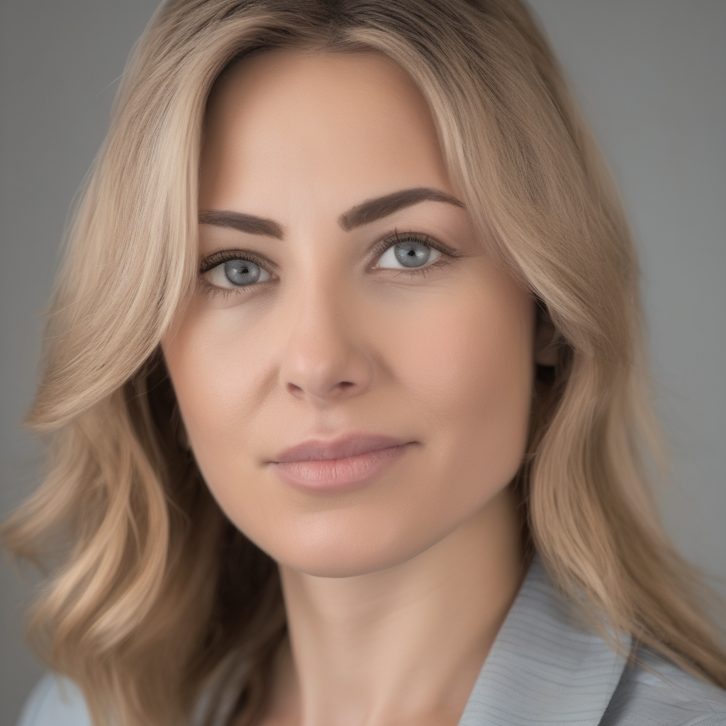
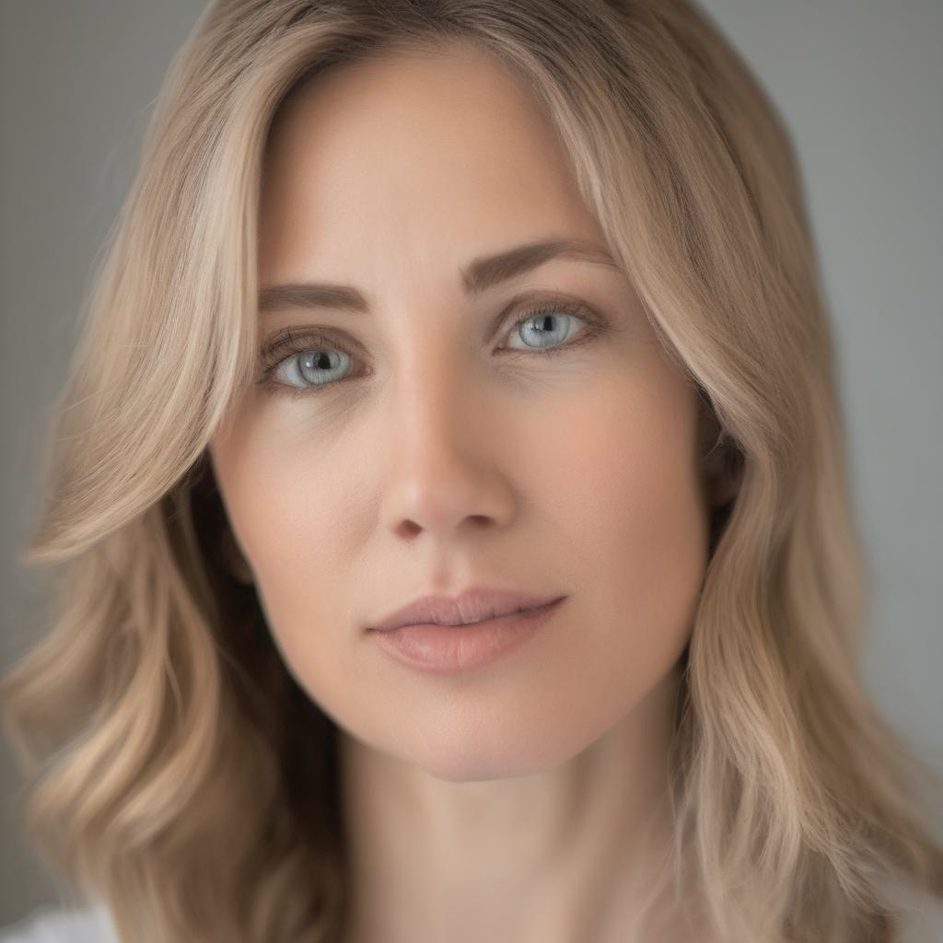
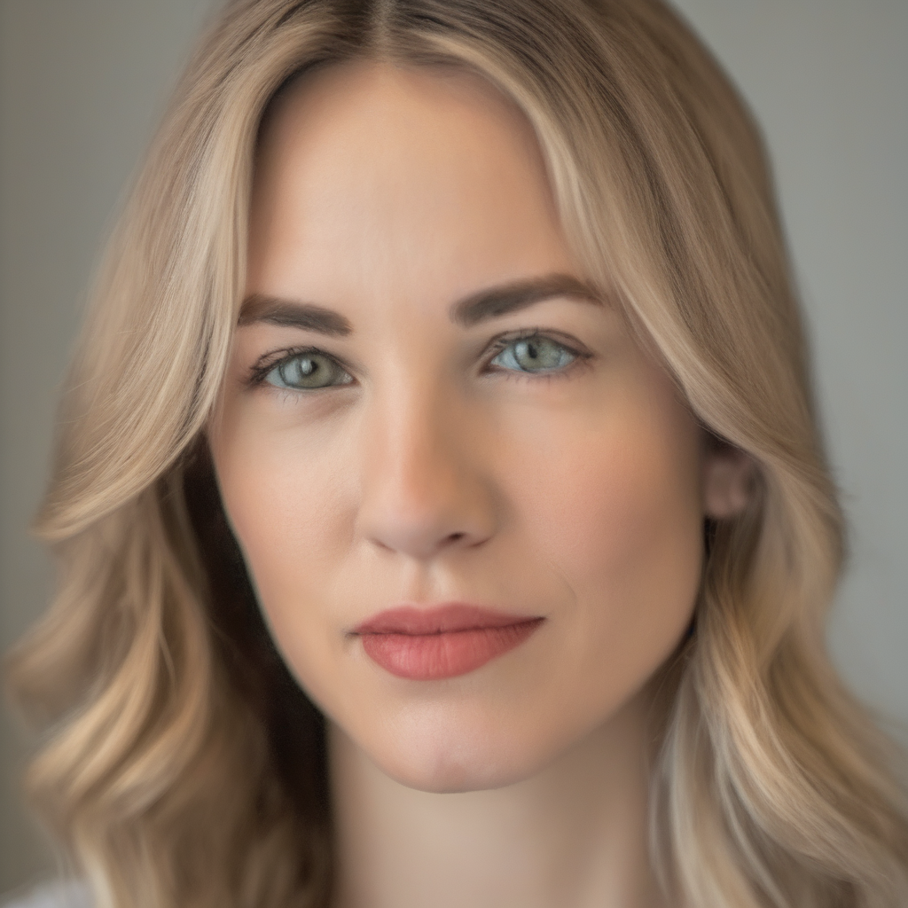
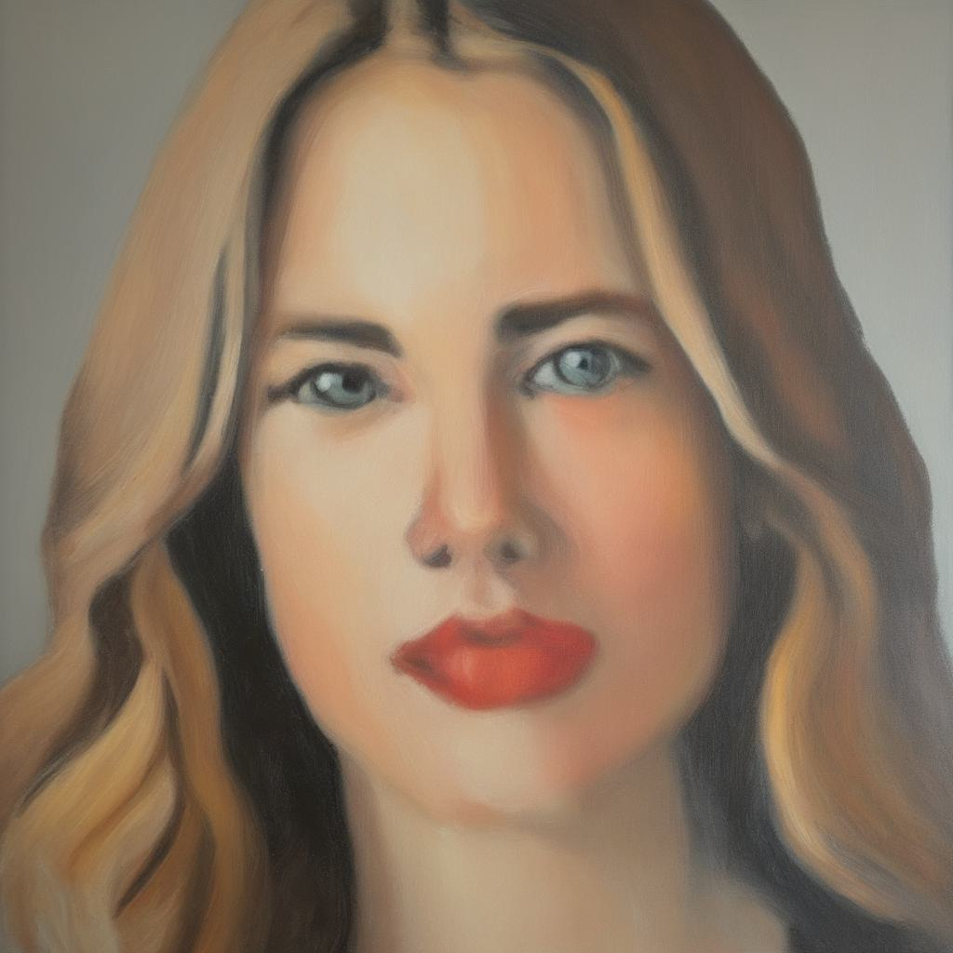
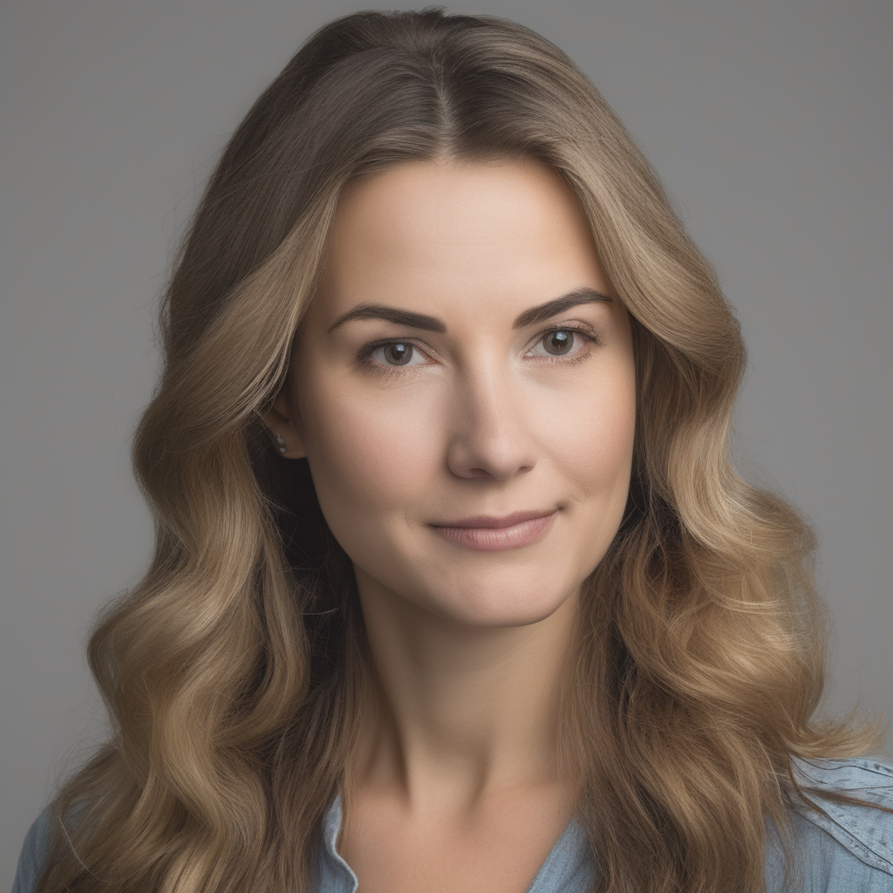
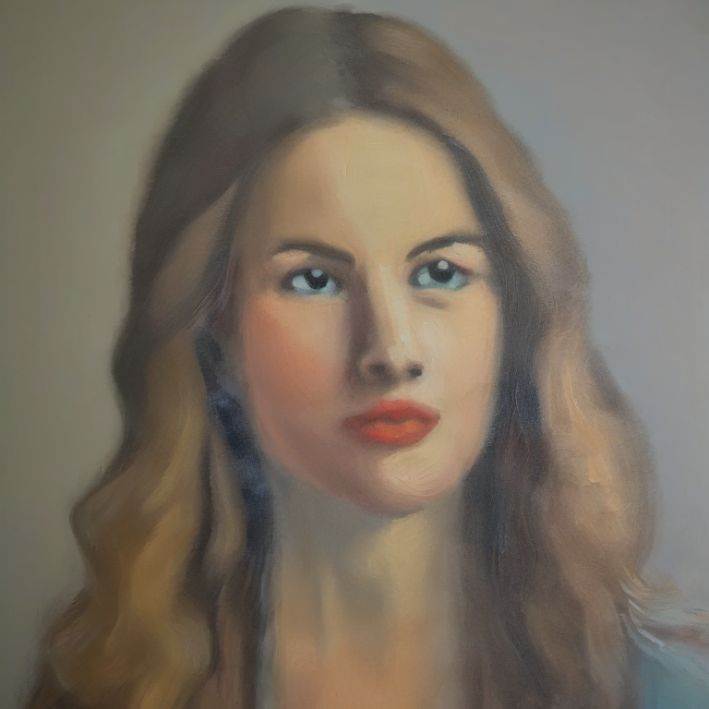
Varying Style Application During Inference
output
$$α∗$$
Baseline Method:
Weight Modulation (Layerwise)
Pretrained Weight Layer
input
Content Image
Style Image
$$α=$$
1
0
Identity and Pose changes
icon credits: vecteezy.com
Notes:
After training, a user may want to control the amount of style present in a generated image. Baseline methods modulate style by modulating the features produced by low rank adapters at every layer via an alpha weighting term. For instance, one may increase or decrease the alpha value to apply more style.
Given a trained model, setting alpha equal to 0 corresponds to not using the trained low rank adapters at all. modulating alpha from 0 to 1 applies style, but may change identity and pose from the initial generated image. In this example, the facial shape and pose of the woman changes as alpha changes

Slide 17
Classifier Free Guidance Overview
$$ε_{θ}(x_{t}, t)$$
$$ε_{θ}\left(x_{t}, c_{content},t\right)$$
Notes:
We propose an updated method to apply style, taking insight from classifier free guidance.
In classifier free guidance with some noisy sample x_t, an unconditional noise prediction is generated, followed by a noise prediction conditioned on some text prompt c_content.
the unconditional noise prediction is added to the vector between the unconditional and conditional predictions, and this vector can be scaled to add varying amounts of guidance

Slide 18
Classifier Free Guidance
${{+ λ}_{cfg}(ε}_{θ}\left(x_{t}, c_{content},t\right)$ $− ε_{θ}(x_{t}, t))$
$$ε_{θ}(x_{t}, t)$$
Notes:
... the unconditional noise prediction is added to the vector between the unconditional and conditional predictions, and this vector can be scaled to add varying amounts of guidance

Slide 19
Our Style Guidance
$$ε_{θ_{style}}\left(x_{t}, c_{style},t\right)$$
$$ε_{cfg}$$
$$ε_{θ}\left(x_{t}, c_{content},t\right)$$
Notes:
lets call this noise prediction epislon cfg
we consider the direction between the pretrained model with some original text prompt c_content, and our customized model theta_style with a style text prompt c_style (pause for arrow)

Slide 20
Our Style Guidance
$$ε_{style}$$
${+ λ_{style}(ε}_{θ_{style}}\left(x_{t}, c_{style},t\right)$ $−ε_{θ}\left(x_{t}, c_{content},t\right)$)
$$ε_{cfg}$$
Notes:
we add this direction to the pretrained classifier guidance prediction to achieve our final output.

Slide 21
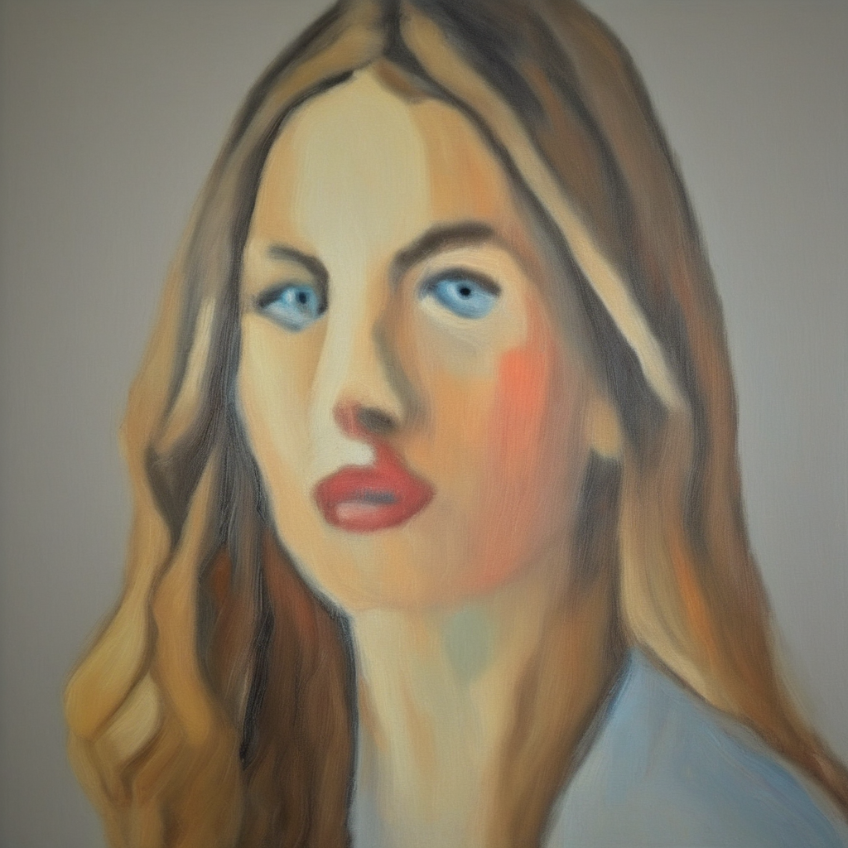
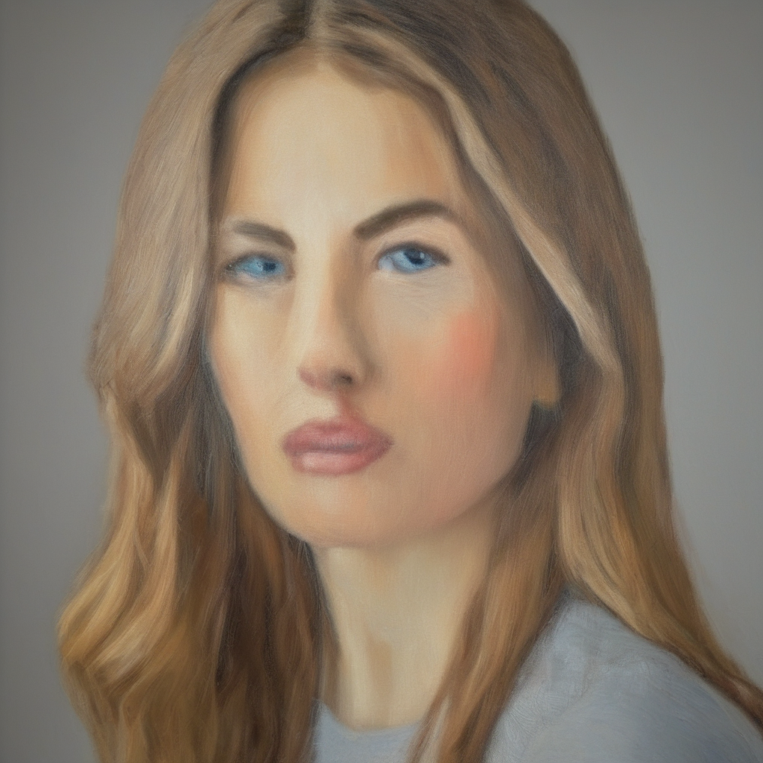
Our Style Guidance
Identity and Pose Retained
$$ε_{style}$$
$$ε_{cfg}$$
Notes:
modulating the size of this additional term can cleanly add style while maintaining identity and pose. Notice how the womans pose and hair positioning stays the same as our style modulation increases

Slide 22
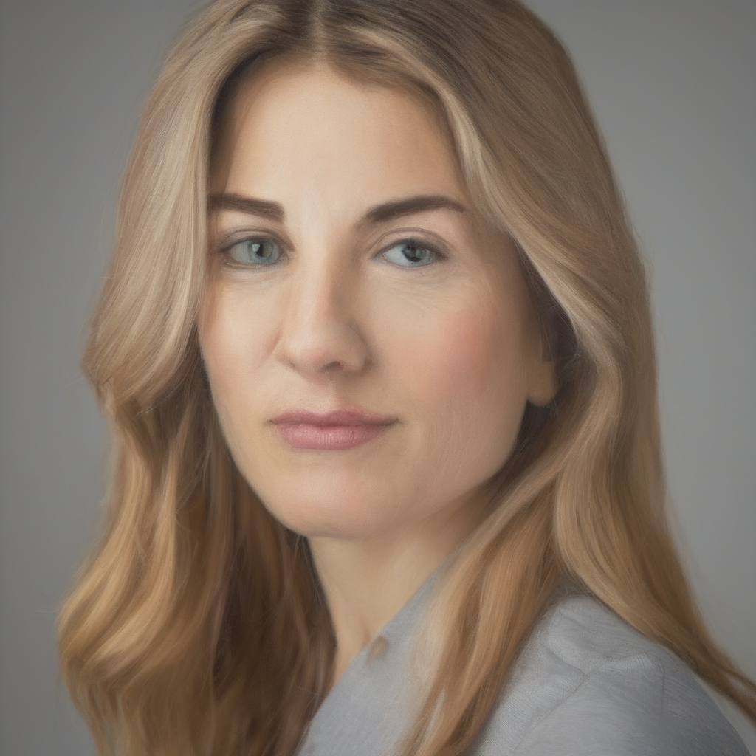
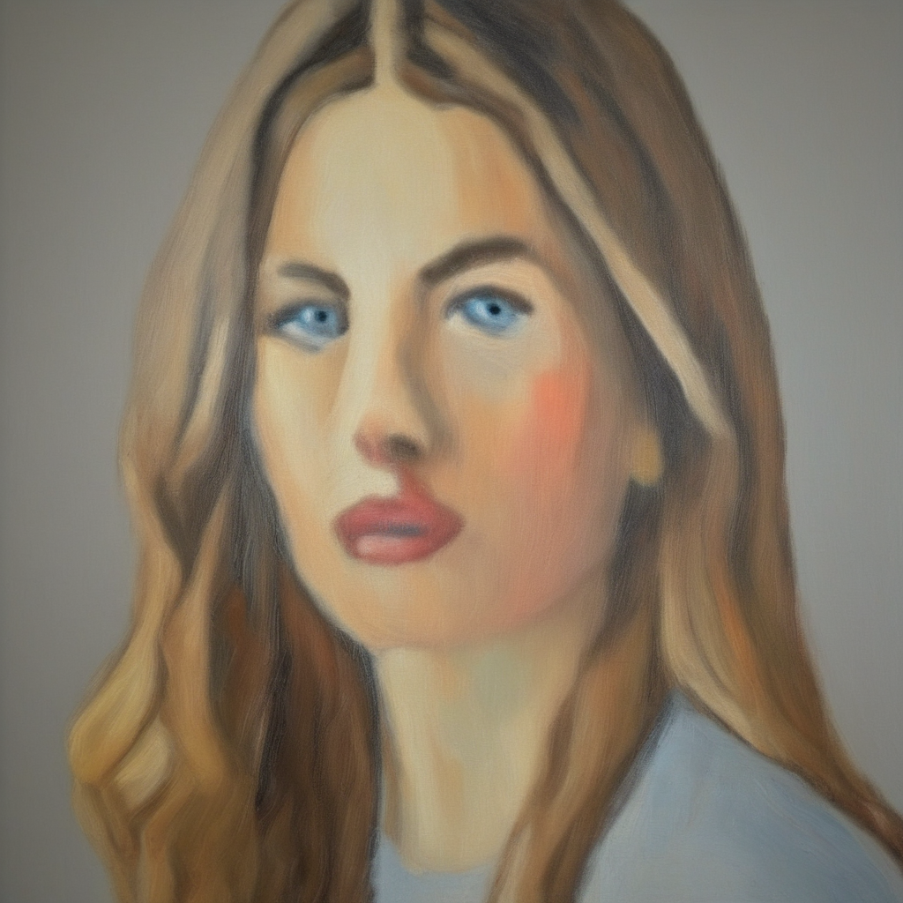
Our Style Guidance Compared to Baseline
Our Style Guidance
Content Image
Style Image
Alpha Scale
Notes:
we compare our stylization control with the baseline method, and see that our method better perserves identity and pose while applying the painting style

Slide 23
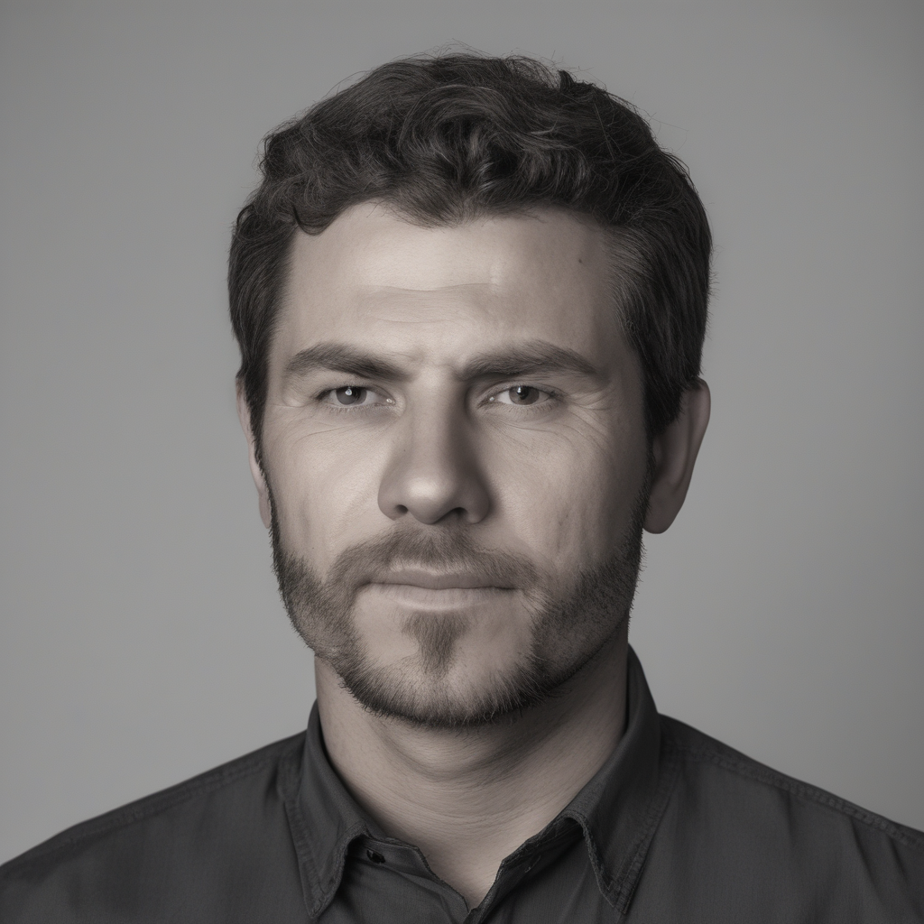
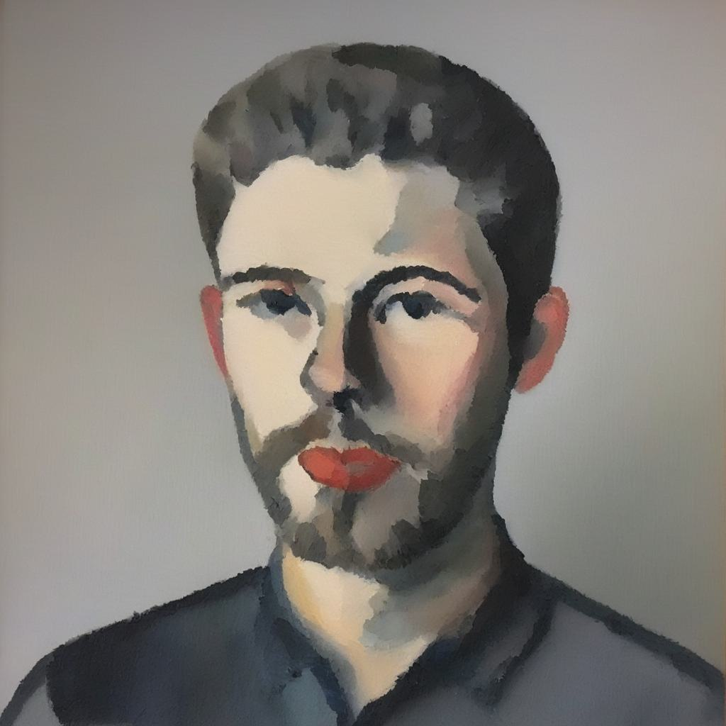
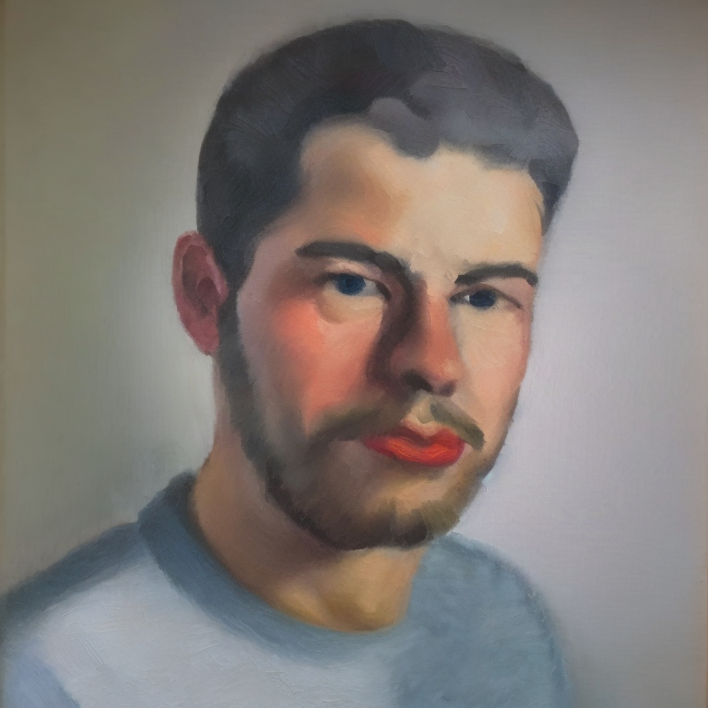
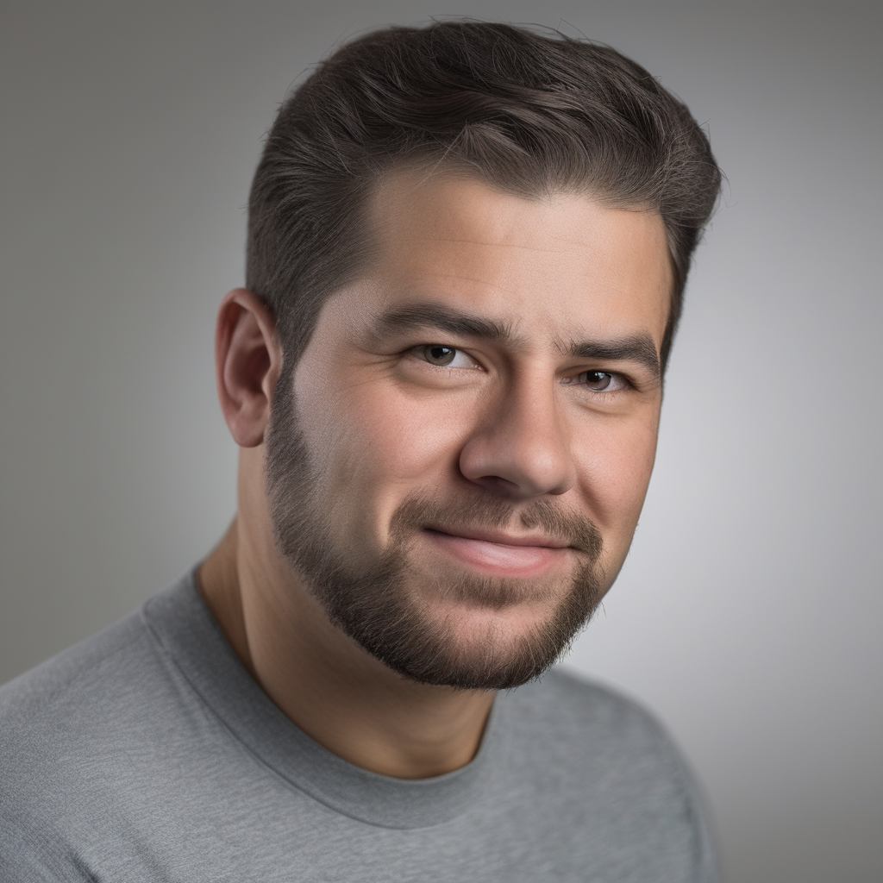
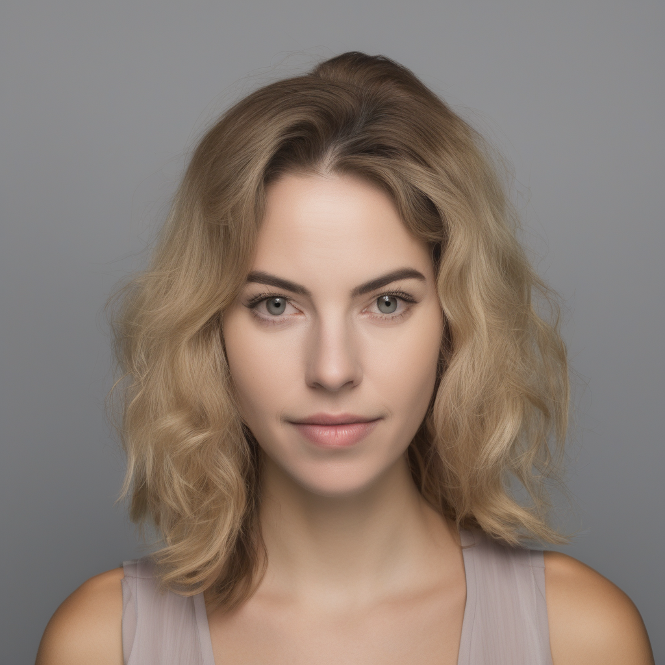
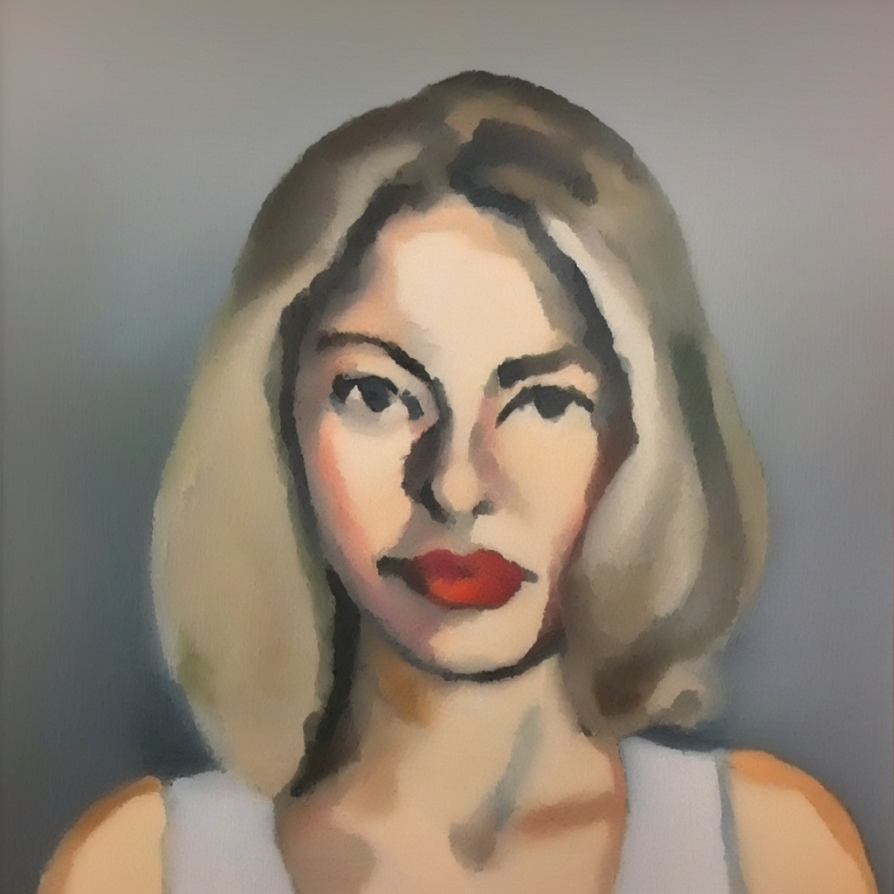
Results
Pretrained Output
Stylized Output
Training Data
Content Image
Style Image
Notes:
Lets look at another example of our method. In this example, the photo turns into a painting, and the mans lips turn a bright red shade. The Pretrained output is from the base denoising model, and our outputs generated from the same seeds correctly apply the style, and turns the subjects lips red.

Slide 24
Prior and Concurrent Works
Optimization Based Methods
Dreambooth LoRA [Ruiz et. al CVPR 2023, Hu et al ICLR 2022]
Styledrop [Sohn et. al NeurIPS 2023]
Finetune on style image only
Concepts Sliders (Concurrent) [Gandikota et. al ECCV 2024]
Encoder Based Methods
IP Adapter [Ye et. al arxiv 2023]
Style Aligned Image Generation (Concurrent) [Hertz et. al CVPR 2023]
Condition on style image only
Notes:
Next lets look at some prior works. Prior optimization based methods only finetune on style images without considering image pairs, and encoder based methods condition only on stylized images when generating new images with the same style. We also show comparison with concurrent optimization based method Concepts Sliders which proses a different paired image training technique.

Slide 25
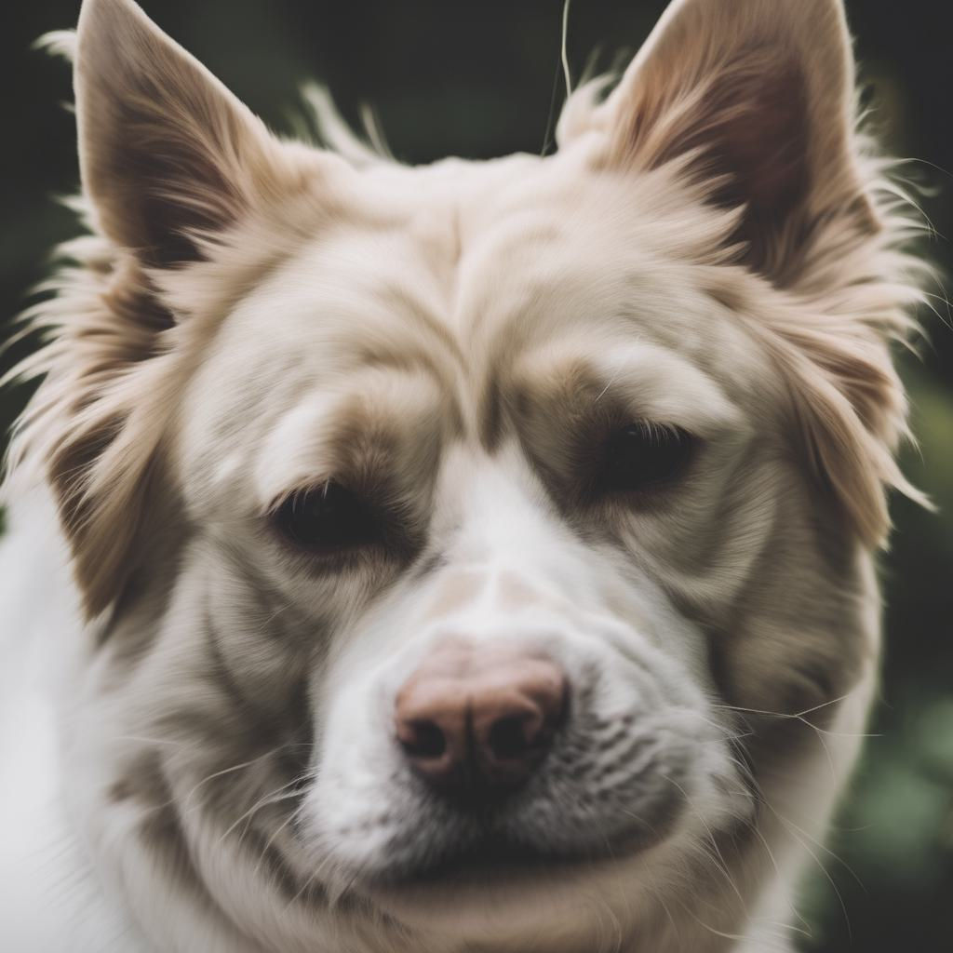
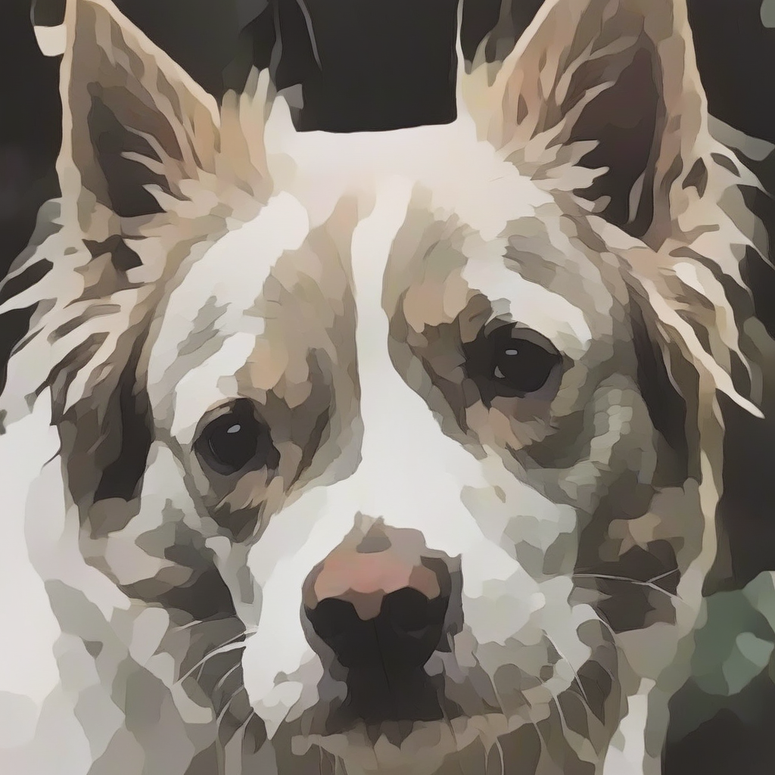
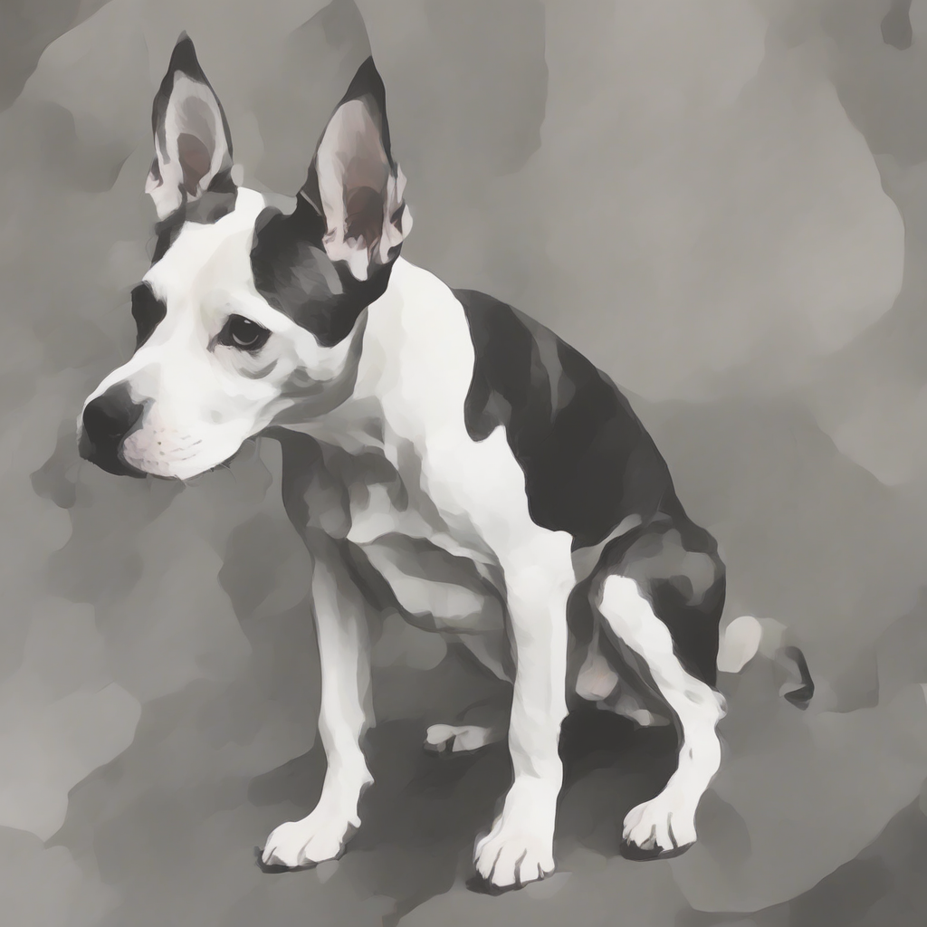
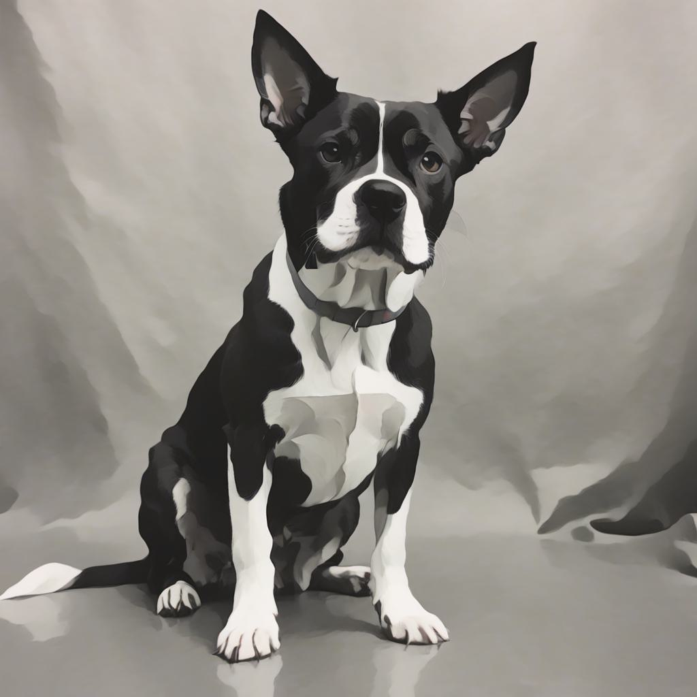
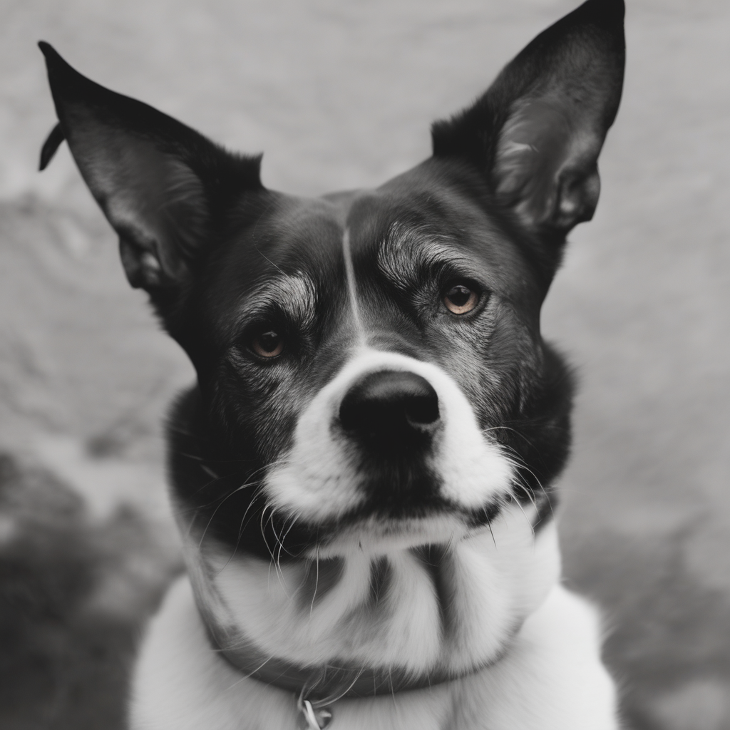
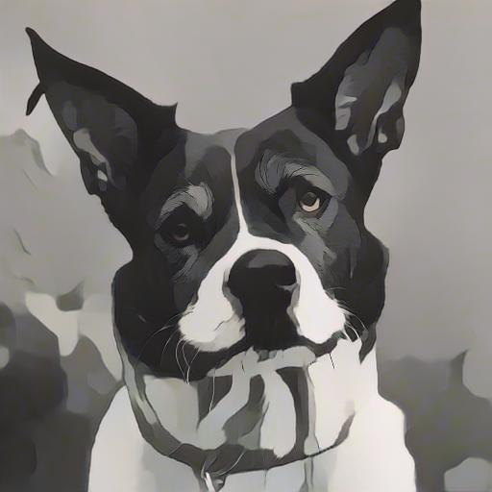
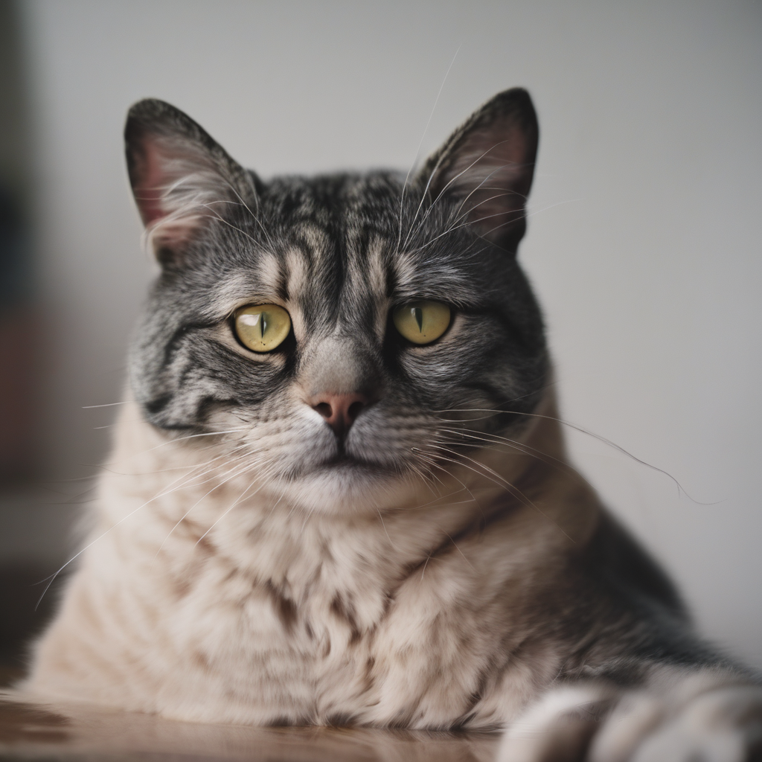
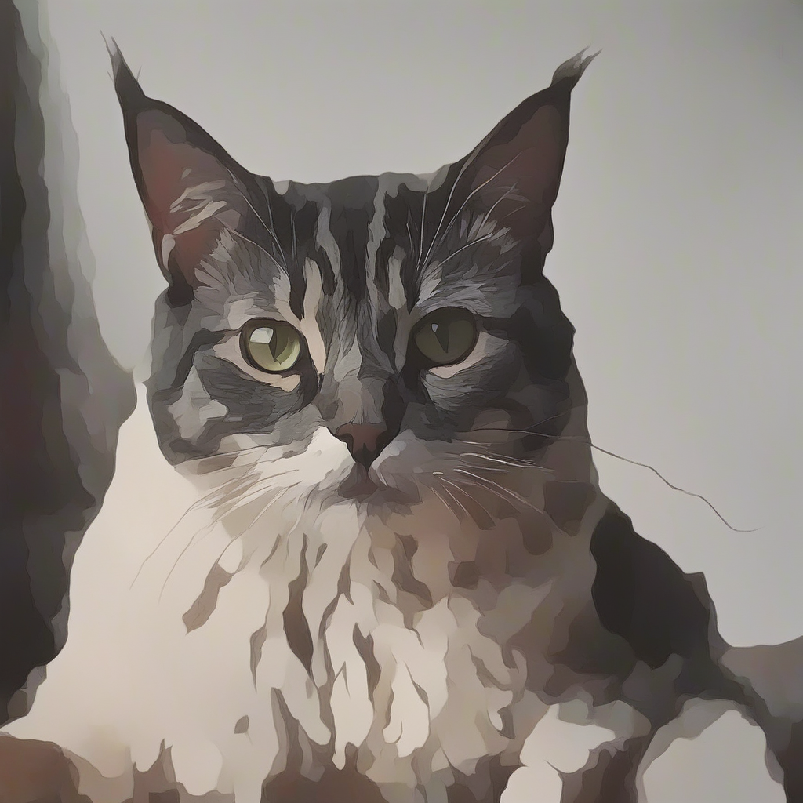
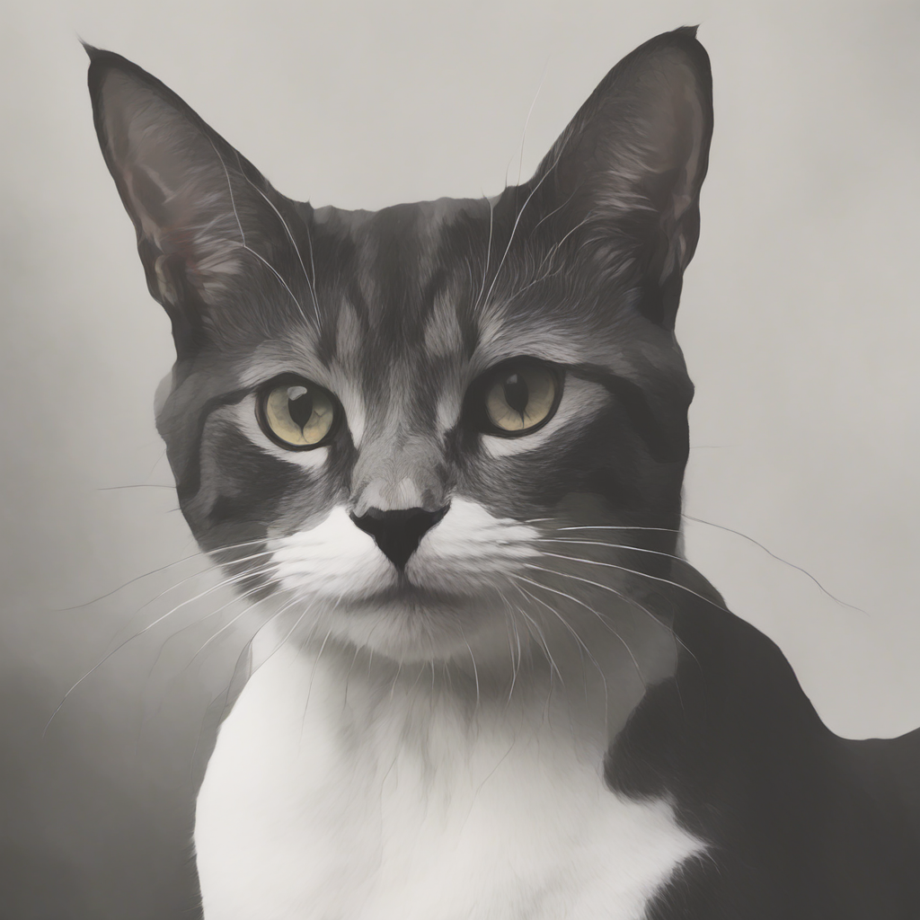
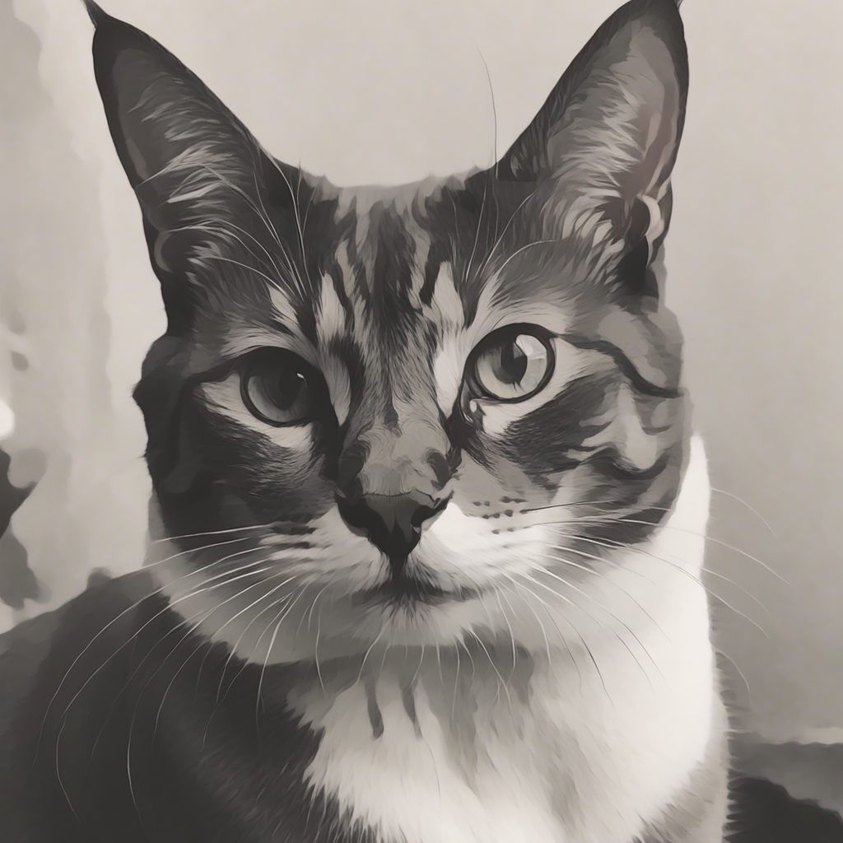
Comparisons: Optimization-Based Methods
Pretrained Output
Ours
Sliders
DB LoRA
Training Data
“A photo of a dog”
Content Image
Style Image
“A photo of a cat”
Notes:
Here is another example of our work, this time with the stylization being more subtle. Here, a cartoonization effect is added to the training content image. Looking at the pretrained model output, our method can accurately generate new images with the cartoonization effect without overfittig to the content image (pause). Our method also outperforms other optimization-based baselines.

Slide 26
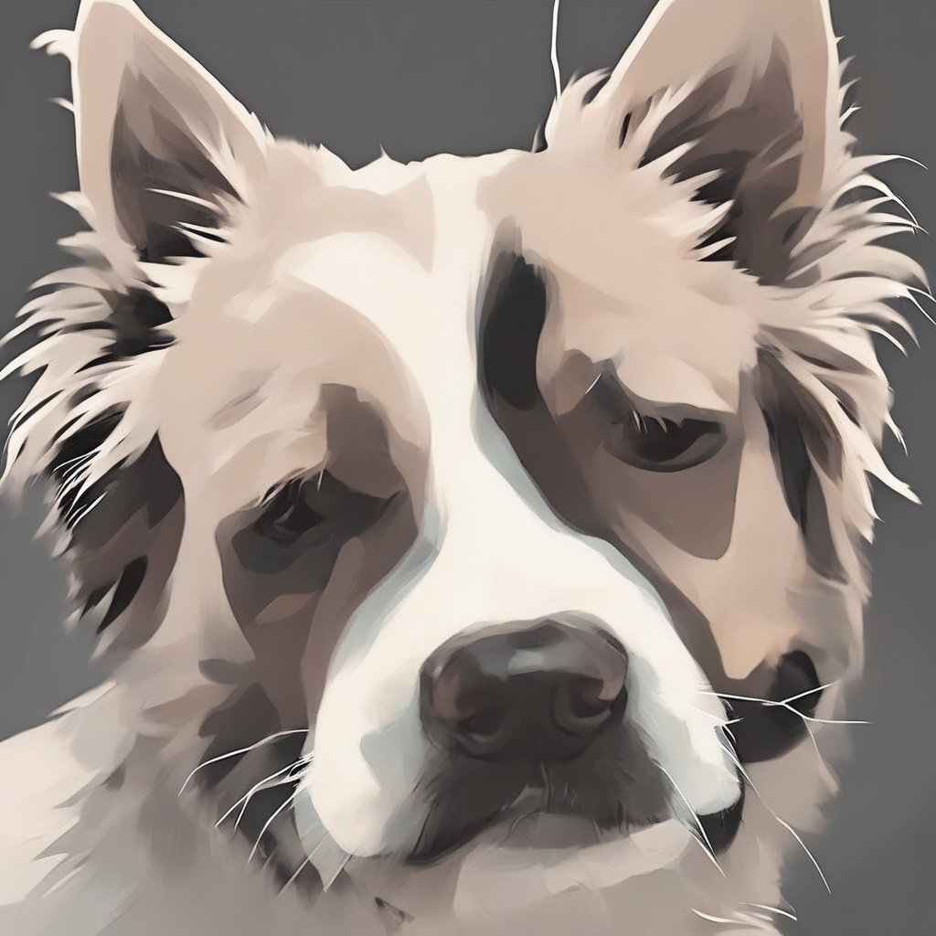
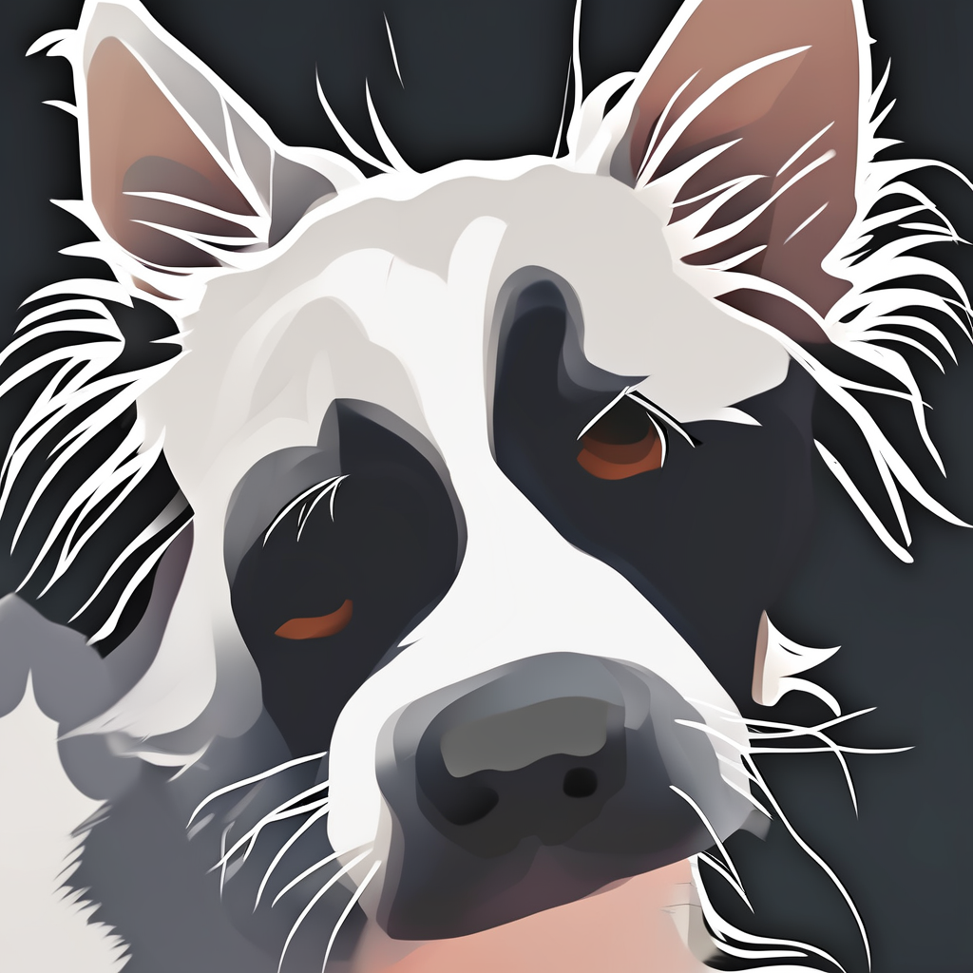
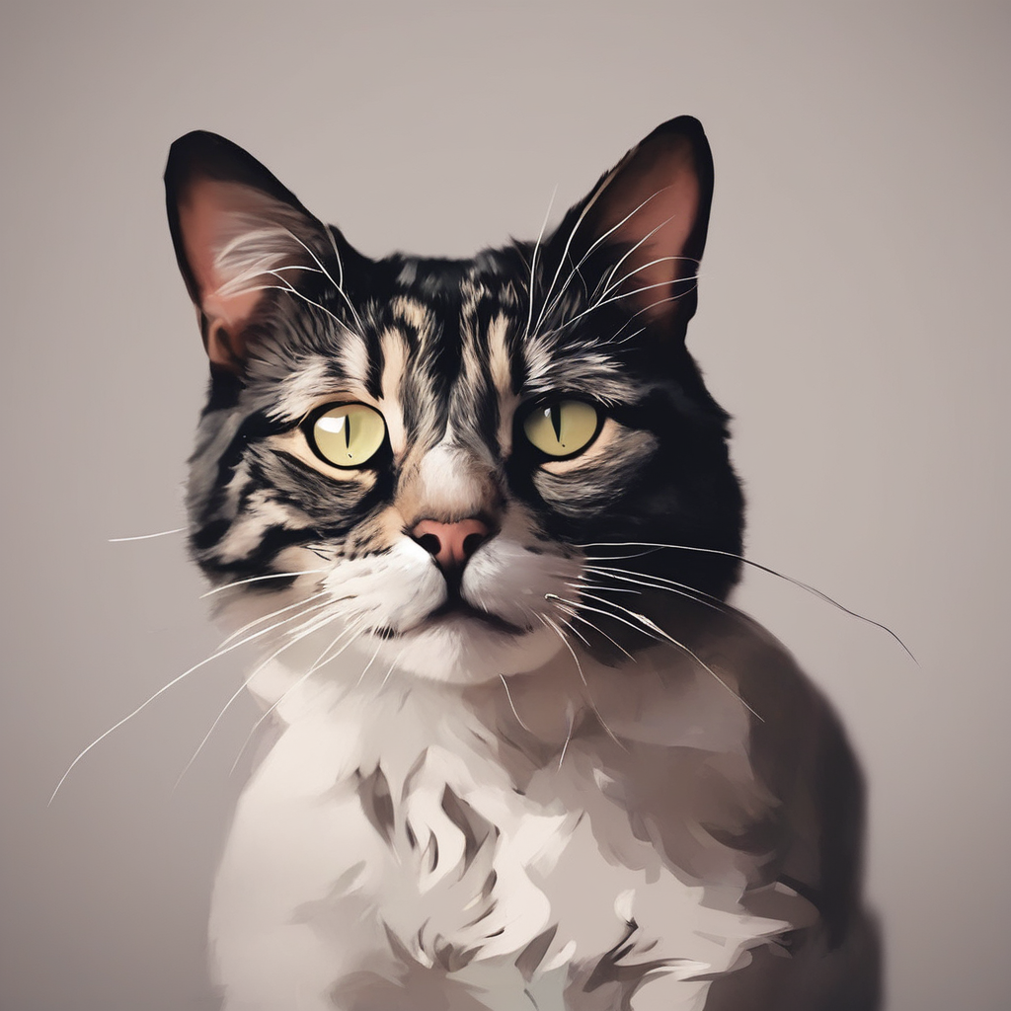
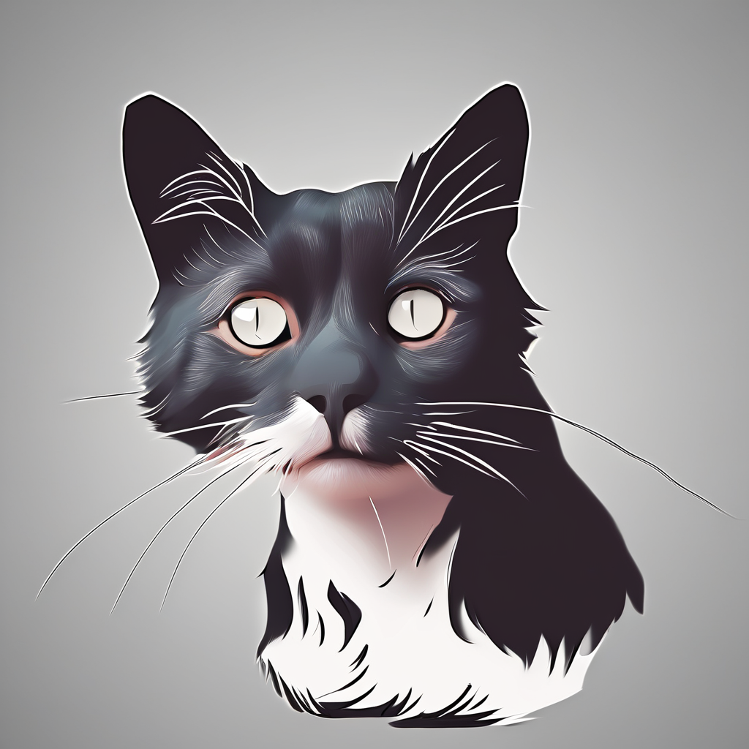
Comparisons: Encoder Based Methods
Style-Aligned + Edgemap
IP Adapter + Edgemap
Pretrained Output
Ours
Training Data
Content Image
Style Image
“A photo of a dog”
“A photo of a cat”
Notes:
similarly, our method outperforms encoder based methods, even when they are conditioned on the edgemap of the pretrained output images.

Slide 27
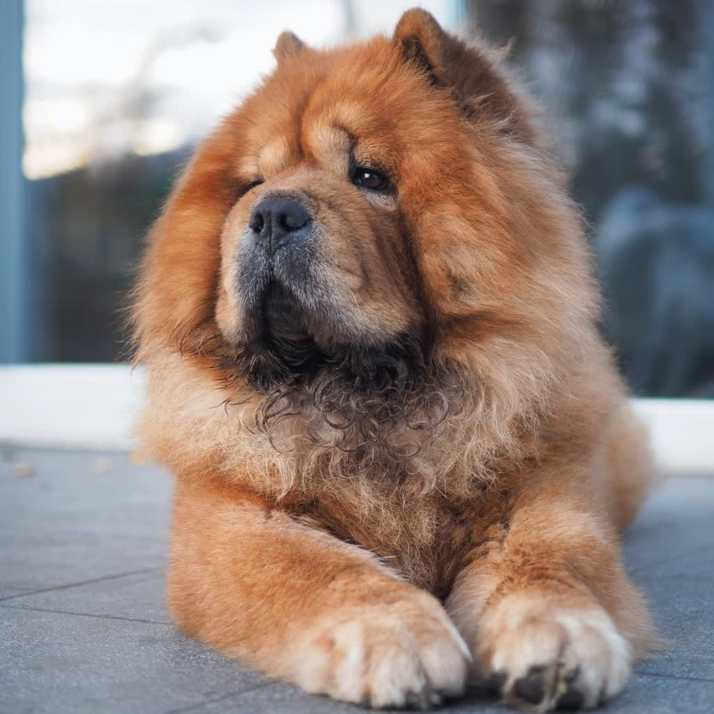
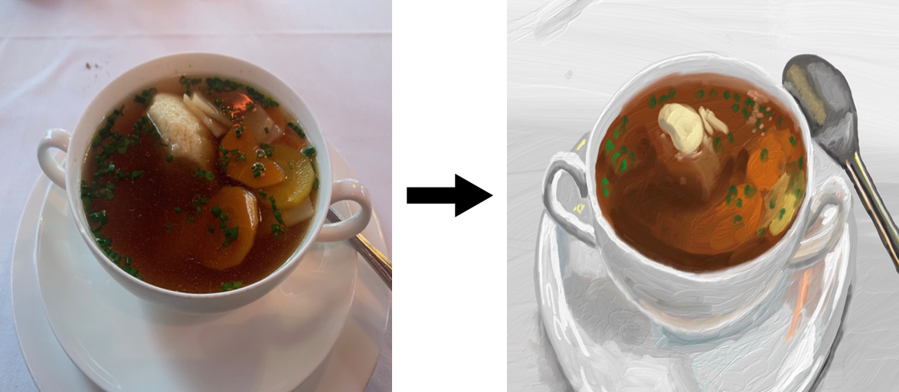
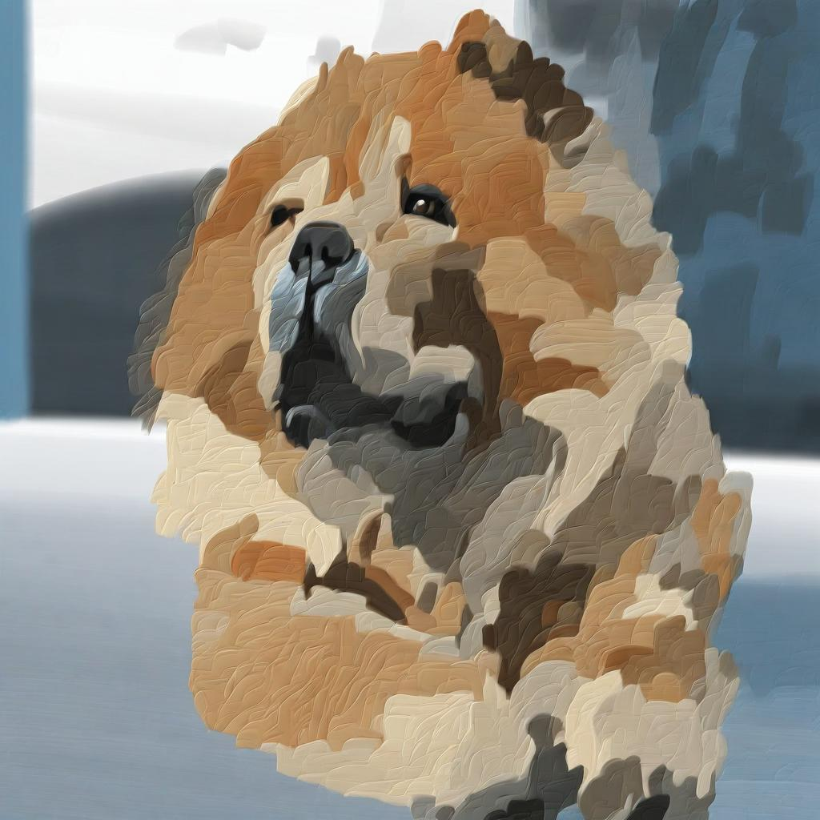
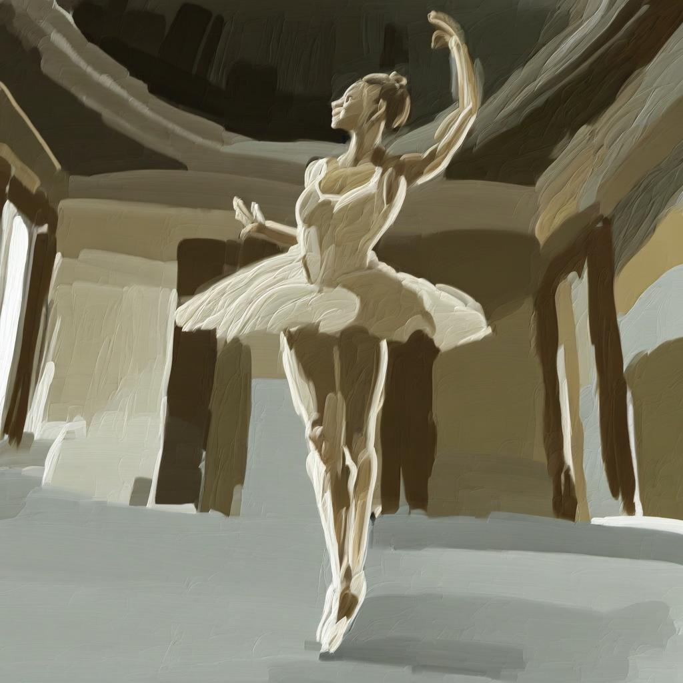
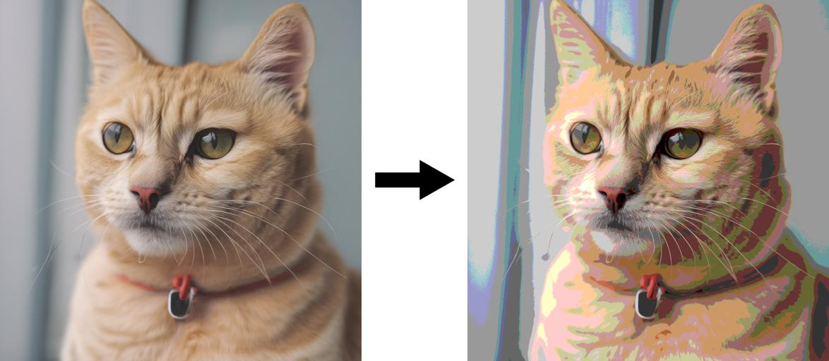
Real Image Editing
Real Image
Training Style Pair
Content image
Style image
Notes:
Our method can also be used for real image editing. Given multiple Models trained with our method on different style pairs and a set of real images, we can edit these real images to apply style. Notice how the content of each real image is preserved, while they take on the corresponding style from the training pairs

Slide 28
Limitations
Object Pose or Background may change
Notes:
Our method also has limitations. It will not always generate paired style images from the same noise seed, and can change object pose or background compared to the pretrained output

Slide 29
Thanks!!
Website: https://paircustomization.github.io/
Github: https://github.com/PairCustomization/PairCustomization
Now with FLUX compatilibity!!
project page
🥳 🥳
Pretrained Output
Ours
Content Image
Style Image
Notes:
thanks for coming, and here's a QR code to our project page and links to our website and github
Our github also recetly supports FLUX training, which is a new, bigger denosing generative model for text to image generation.

